Slide 1
Bayesian Models for Congregational Data
Simon G. Brauer (sgbrauer@umich.edu)
Research Area Specialist, SRC, University of Michigan
2021 SSSR Annual Meeting
You can find these slides at http://www.simonbrauer.us/presentations/sssr2021.pptx
Special thanks to Mark Chaves and the denomination representatives who provided total congregation counts for my 2017 paper, reused for this project.
Notes:
Statistical data included herein were provided at no charge by the General Council on Finance and Administration of
the United Methodist Church (GCFA) and may be obtained directly from GCFA, PO Box 340020, Nashville, TN 37203-
0029. These data are proprietary and are owned by GCFA and may not be used in any commercial or exploitative way, to
make a financial profit, or in a manner that defames the United Methodist denomination or its agencies or organizations.
GCFA does not endorse any particular use of the data or accept responsibility for their interpretation or analysis
by another.

Slide 2
Simple example
Imagine a census of all residents of a small area
Data collected
- Number of attendees of congregation
- Whether congregation has a website

Slide 3
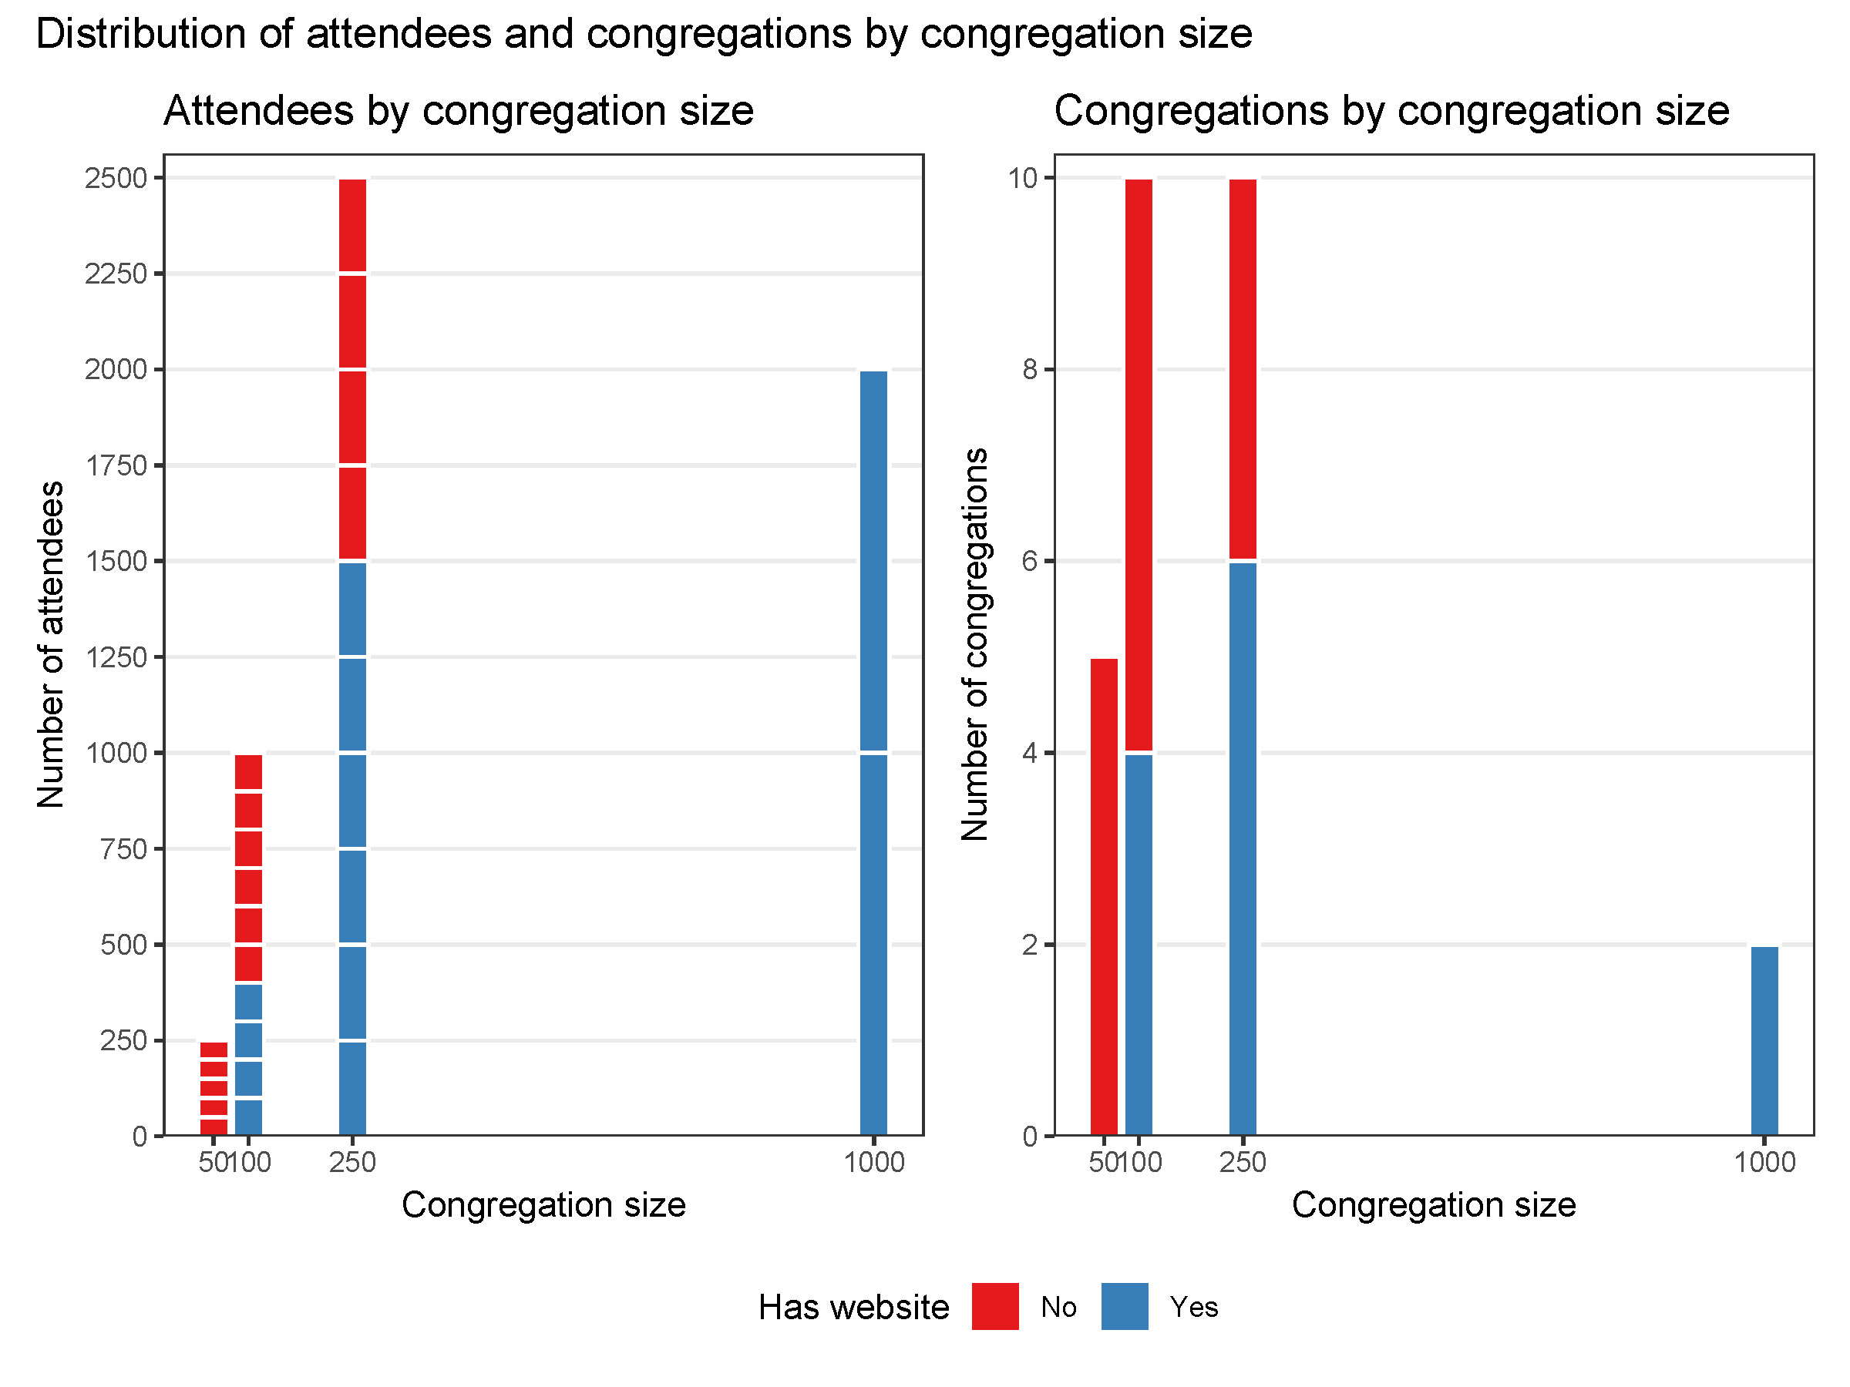

Slide 4
The role of congregation size
Weighting
Treated as fixed
Directly weight the likelihood
Modeling
Treated as random
Specify the joint distribution of size and outcome

Slide 5
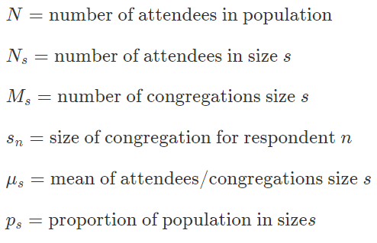
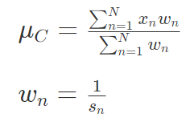
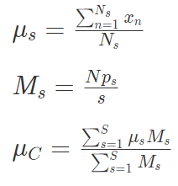
Weighting vs modeling
Weighting
Modeling
We can model these
Calculate mean for congregations of size s
Estimate number of congregations of size s
Weight size-means by number of congregations of that size
Attendee-level mean derived from the same parameters

Slide 6
Advantages of a modeling approach
Accounts for uncertainty of congregation size
Smooths size distributions
Doesn’t rely on sampling theory (easier to interpret)

Slide 7
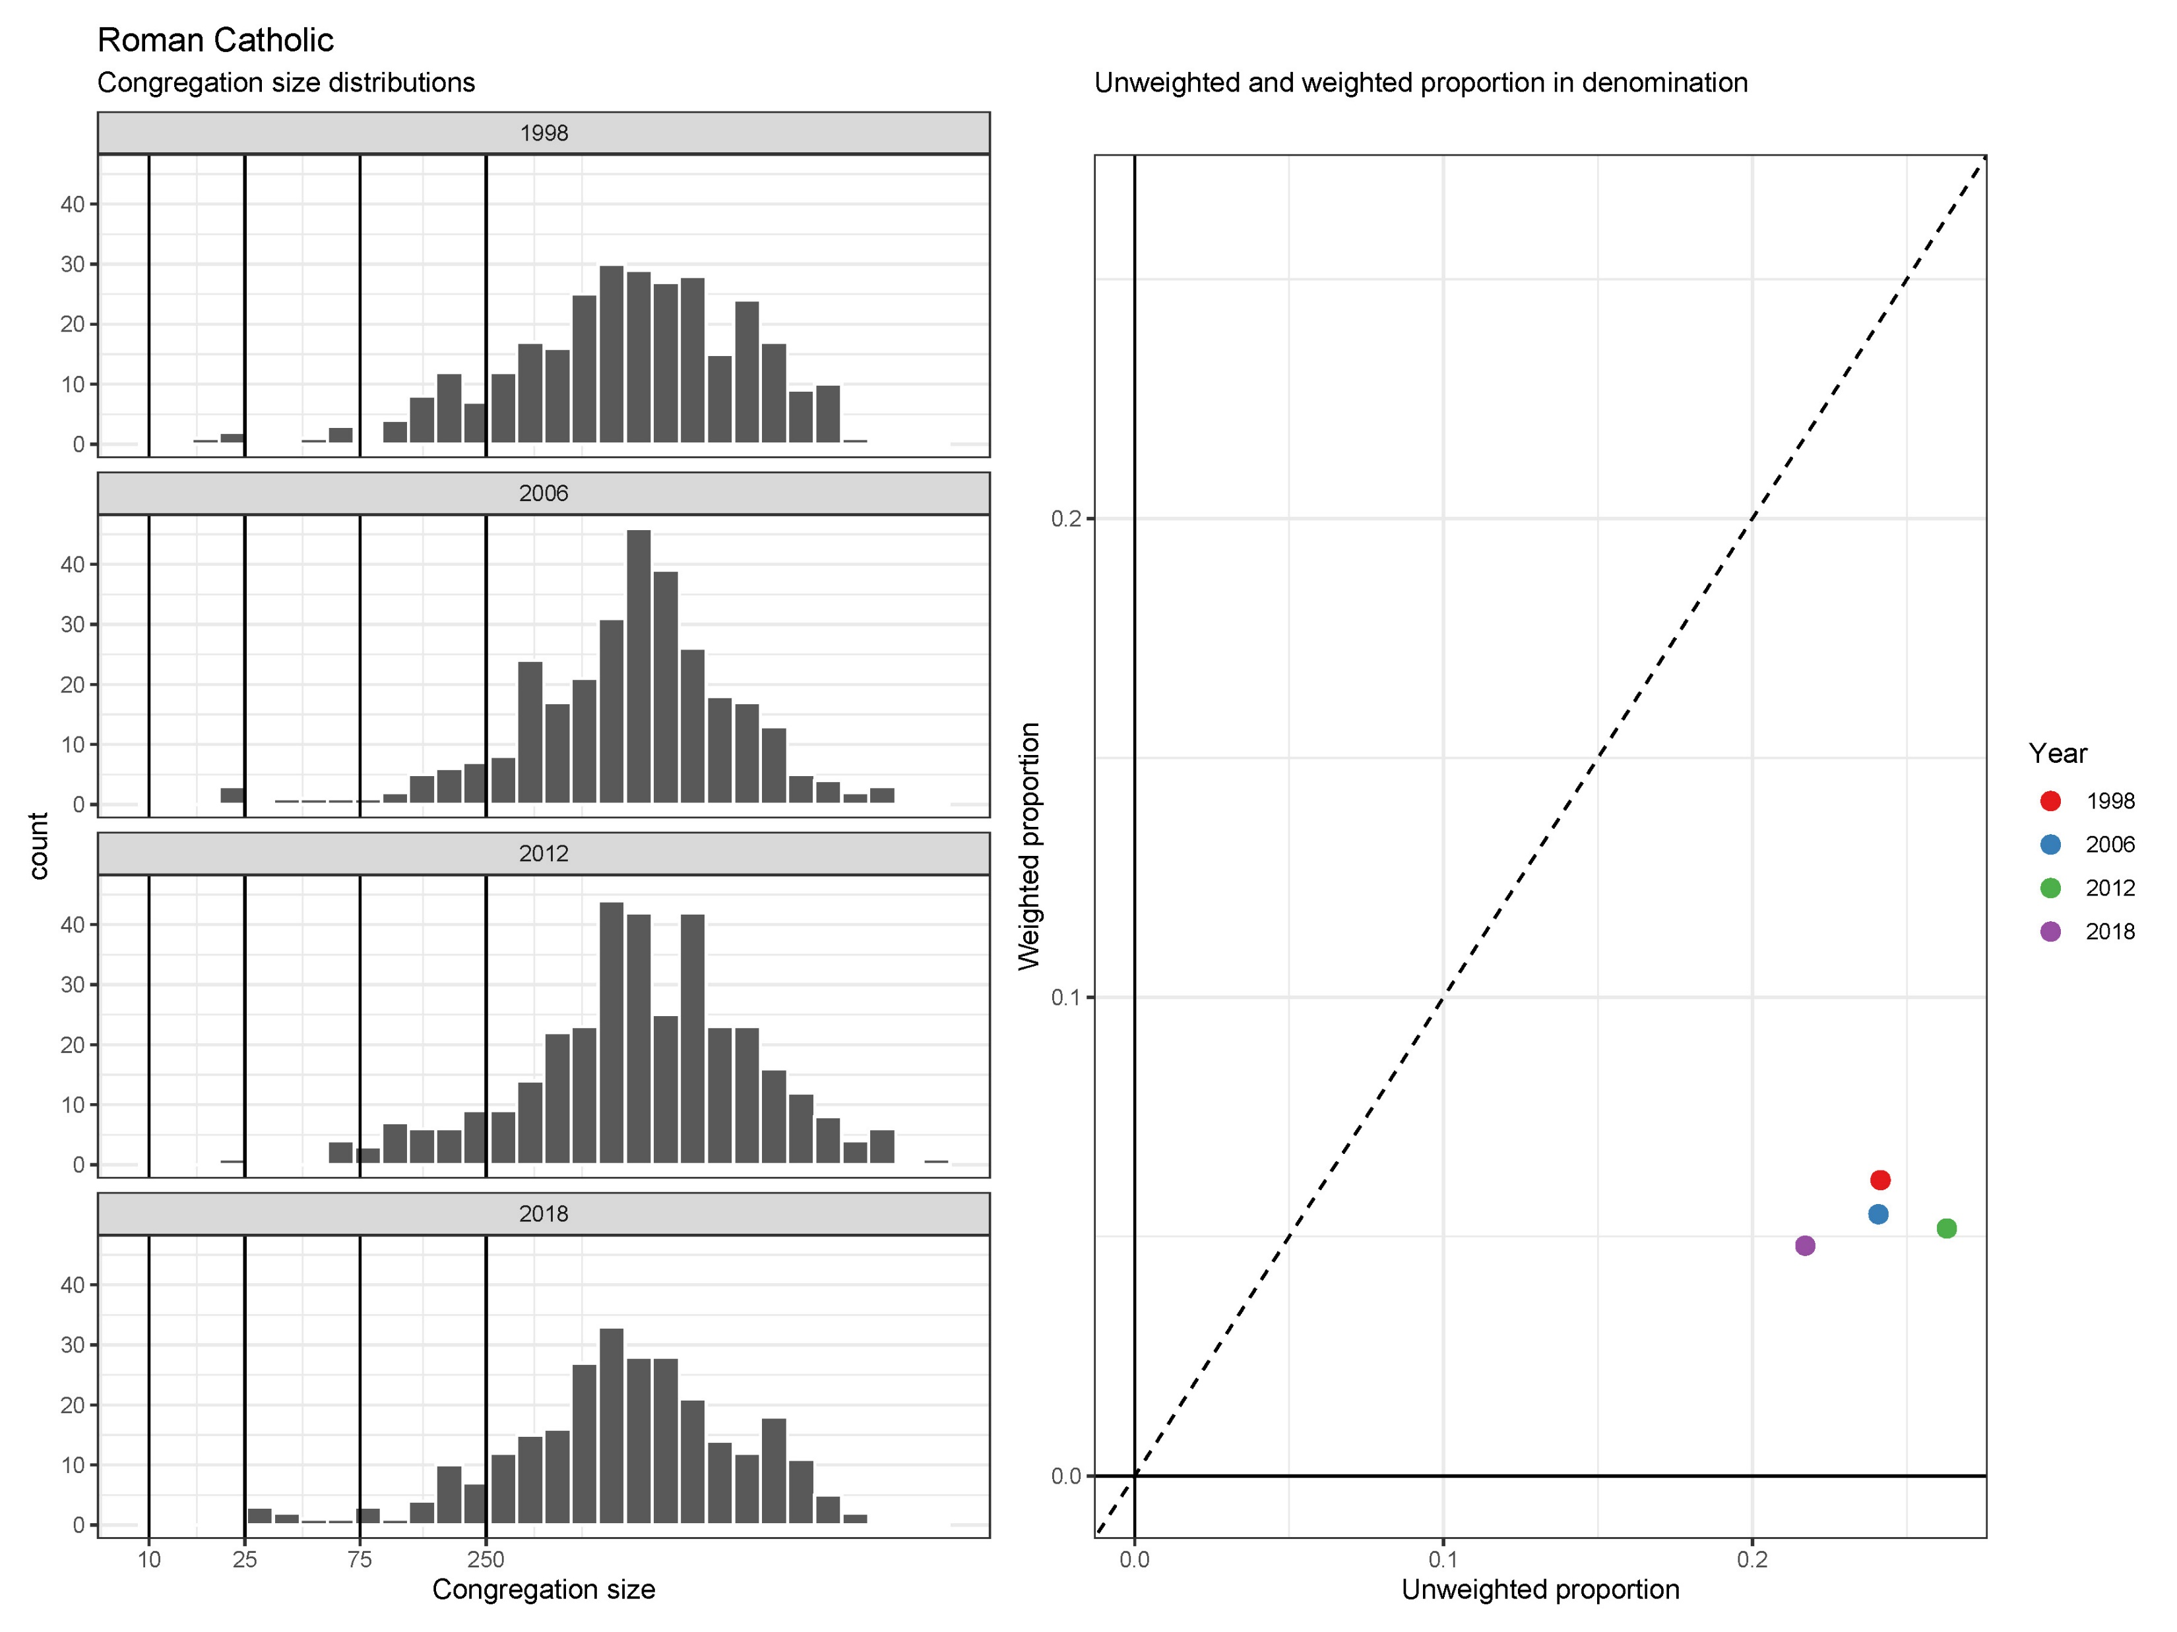
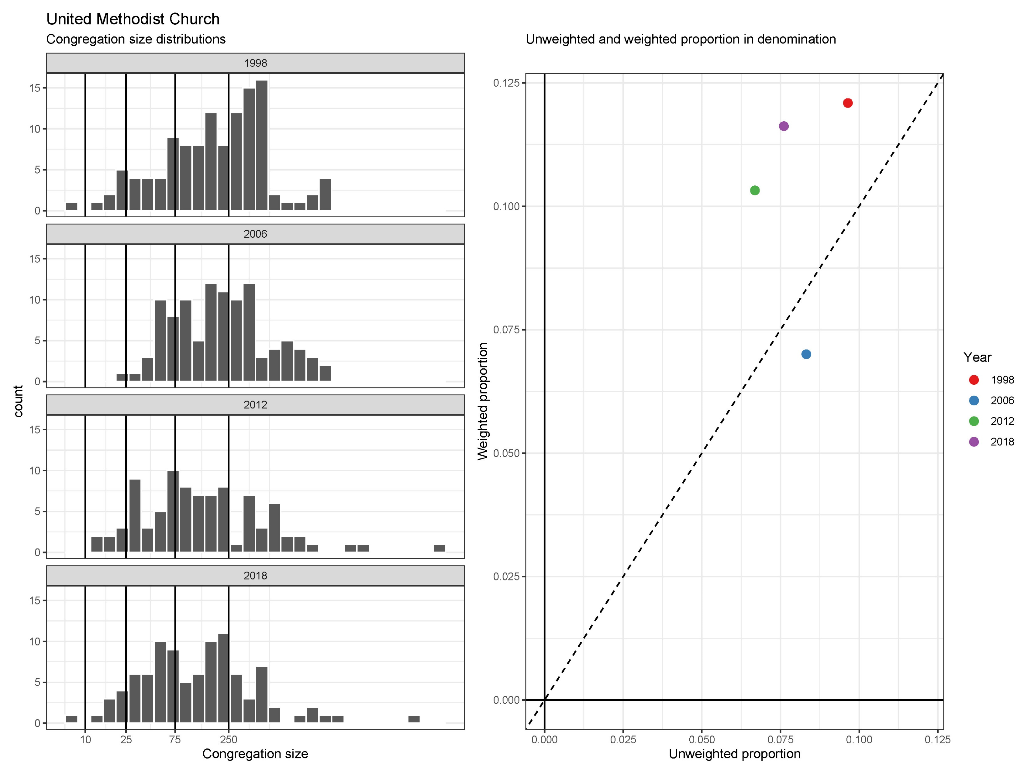

Slide 8
Why Bayesian models?
Primary motivation
Bayesian models use simulation-based methods, which allow the estimation of arbitrary functions of parameters
Secondary motivation
Priors can be helpful for small samples/small area estimation

Slide 9
Data and analyses

Slide 10
Data
NCS 1998, 2006, 2012, and 2018
“Design” variables
Denomination
Congregation size
Outcome
Congregation founded between surveys

Slide 11
Target Quantities
Proportional makeup of denominations
Total number of congregations
Number of congregations closed and opened between survey waves

Slide 12
Features of the Model
Denomination
Congregation size
Congregation founded between surveys
Practical implications
Each parameter is…
…unique to a denomination
…a linear functions of time (smooth)
…shrunk via hierarchical modeling (regularization)
Notes:
d = denomination
t = time
i = respondent
Not shown: parameter_dt = some_function(alpha_p + beta_p * t)

Slide 13
Results

Slide 14
Proportional makeup

Slide 15
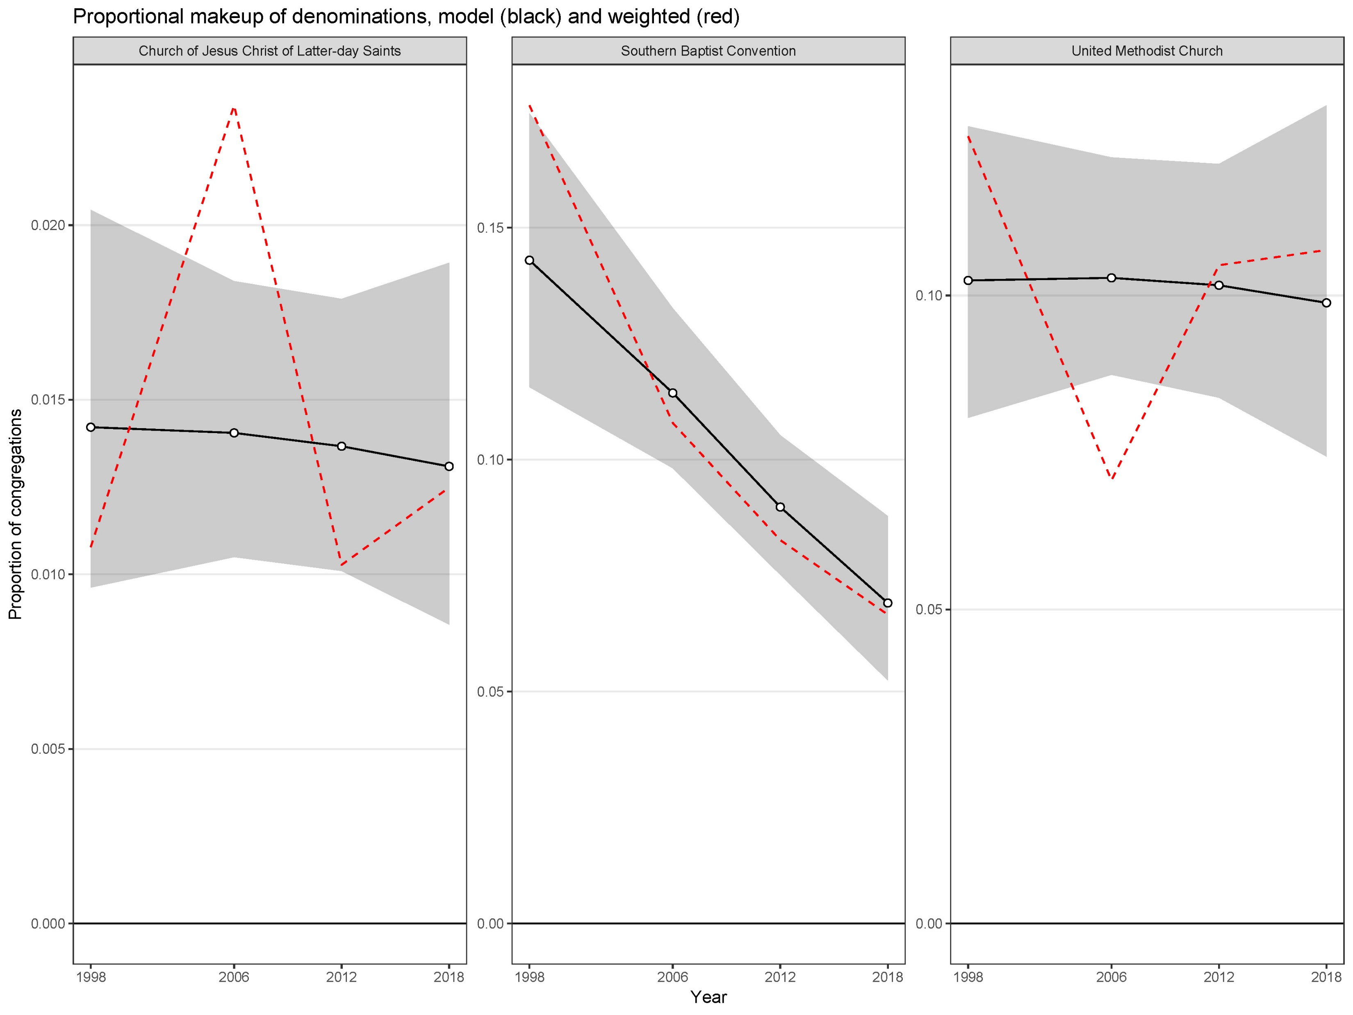
Proportional makeup

Slide 16
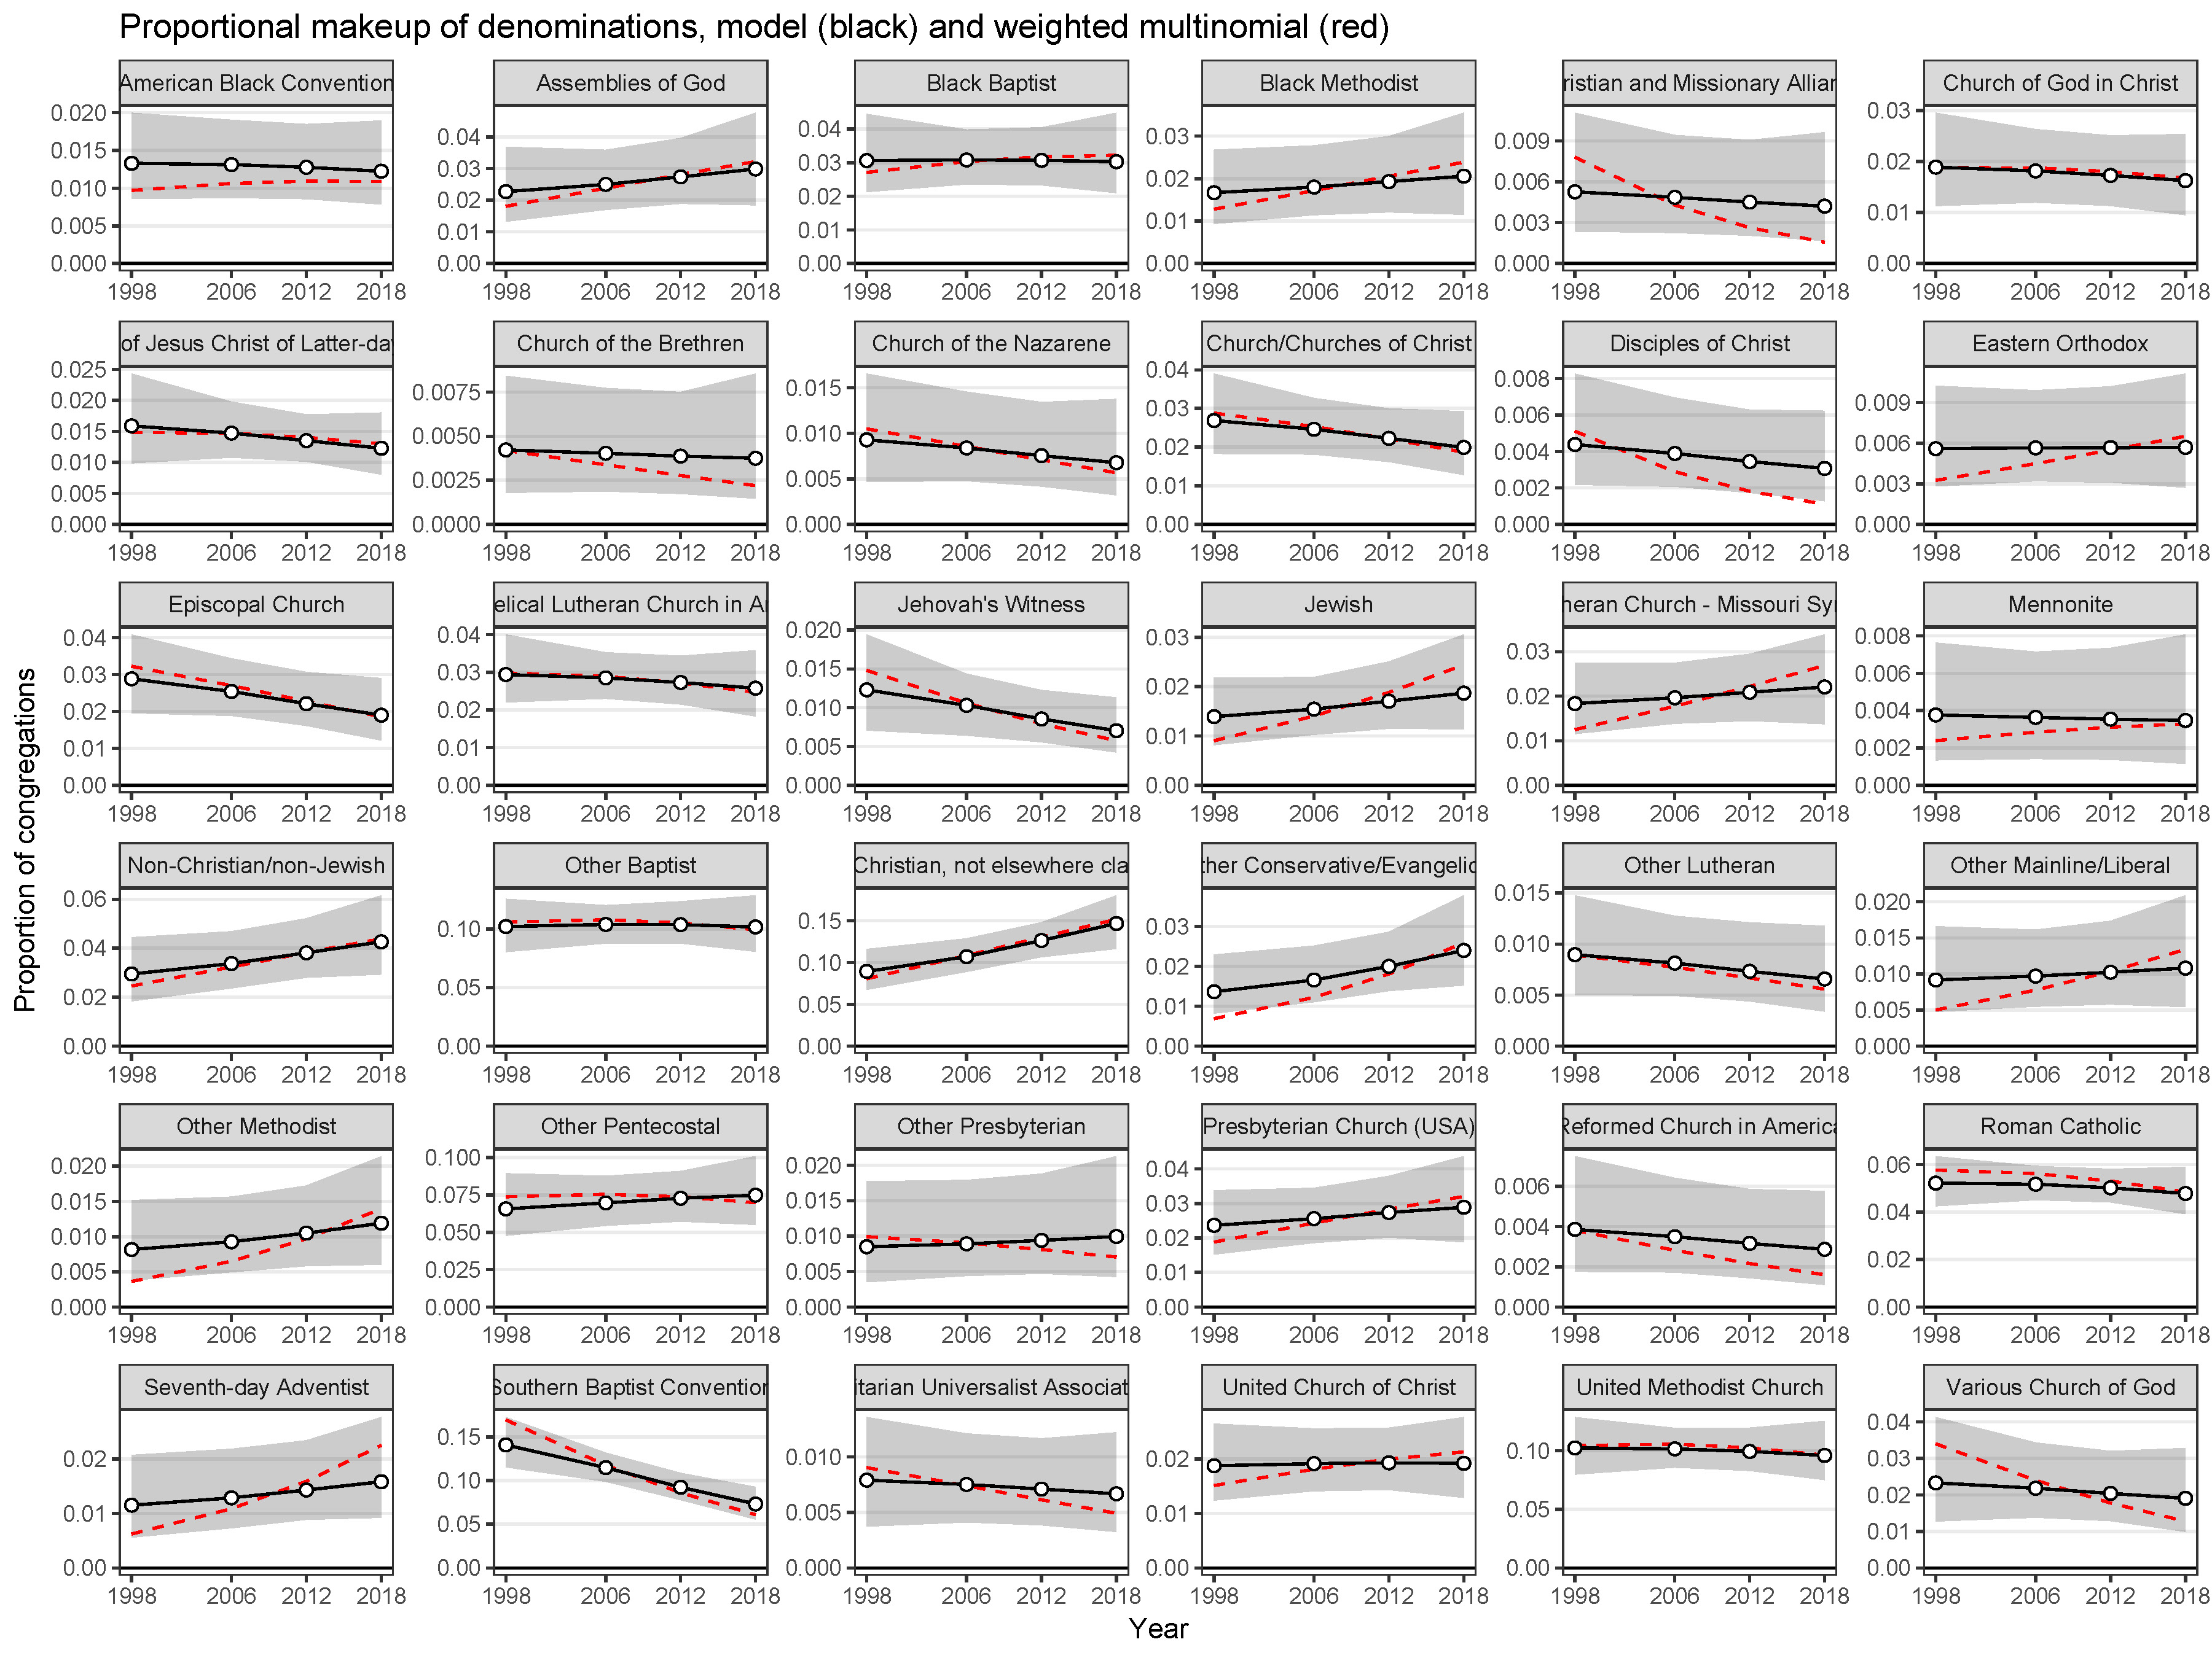
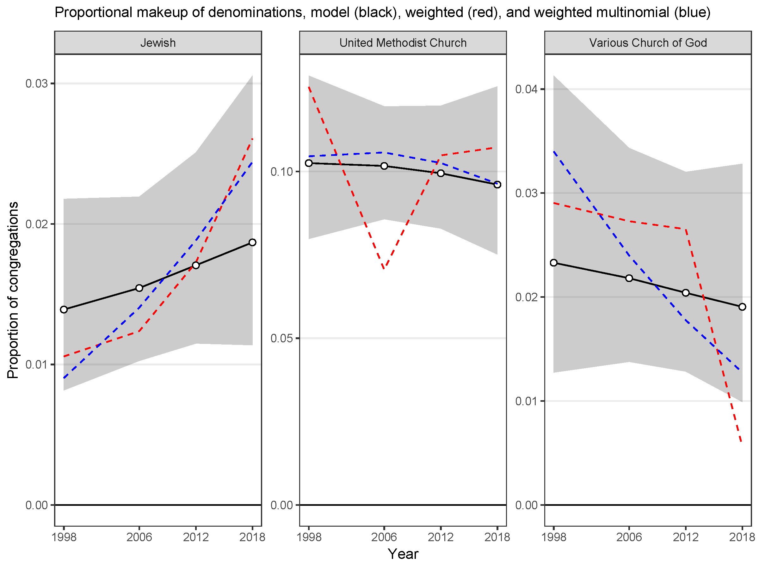

Slide 17
Total number of congregations

Slide 18
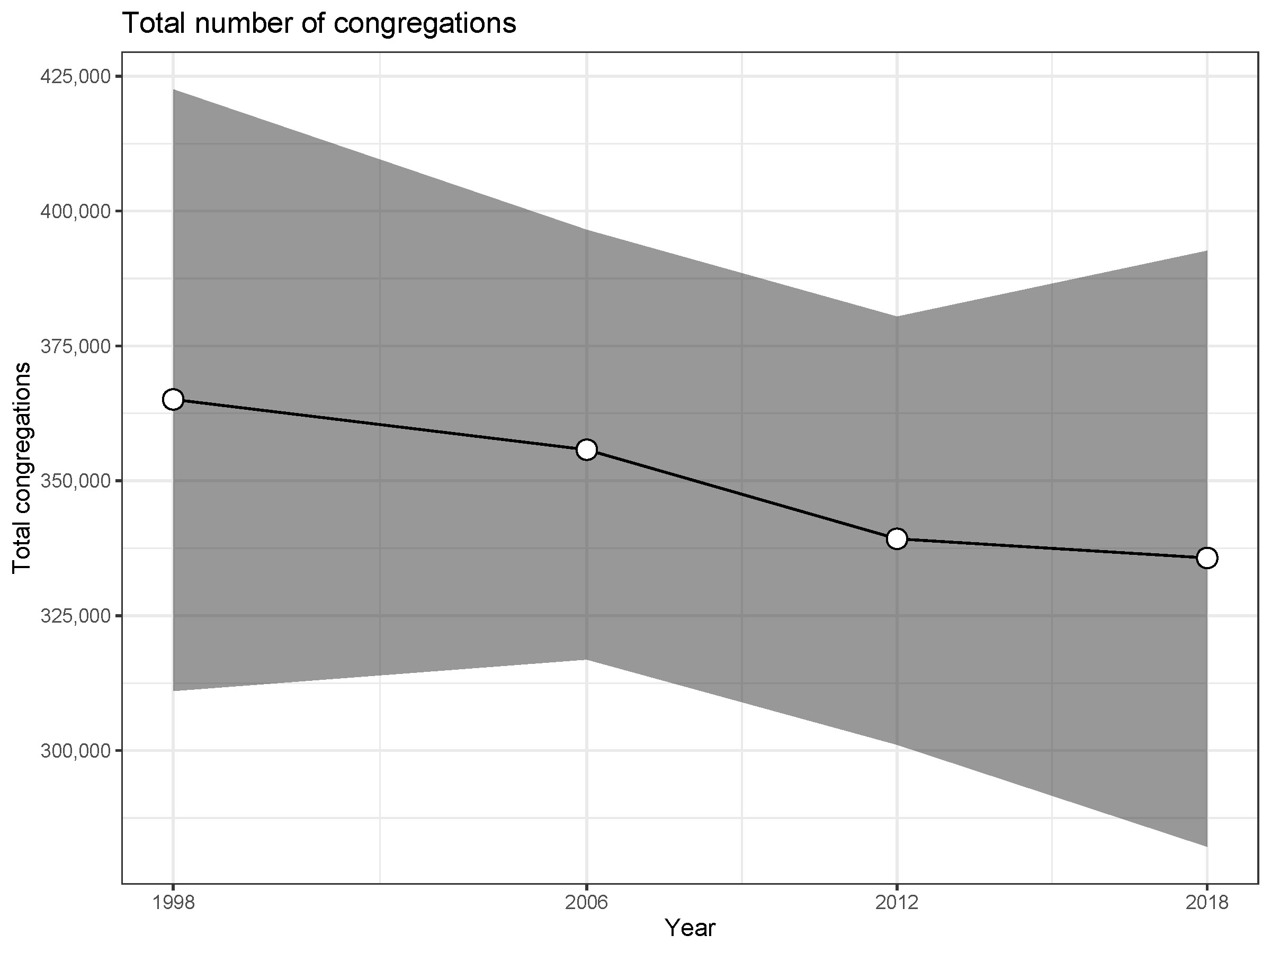
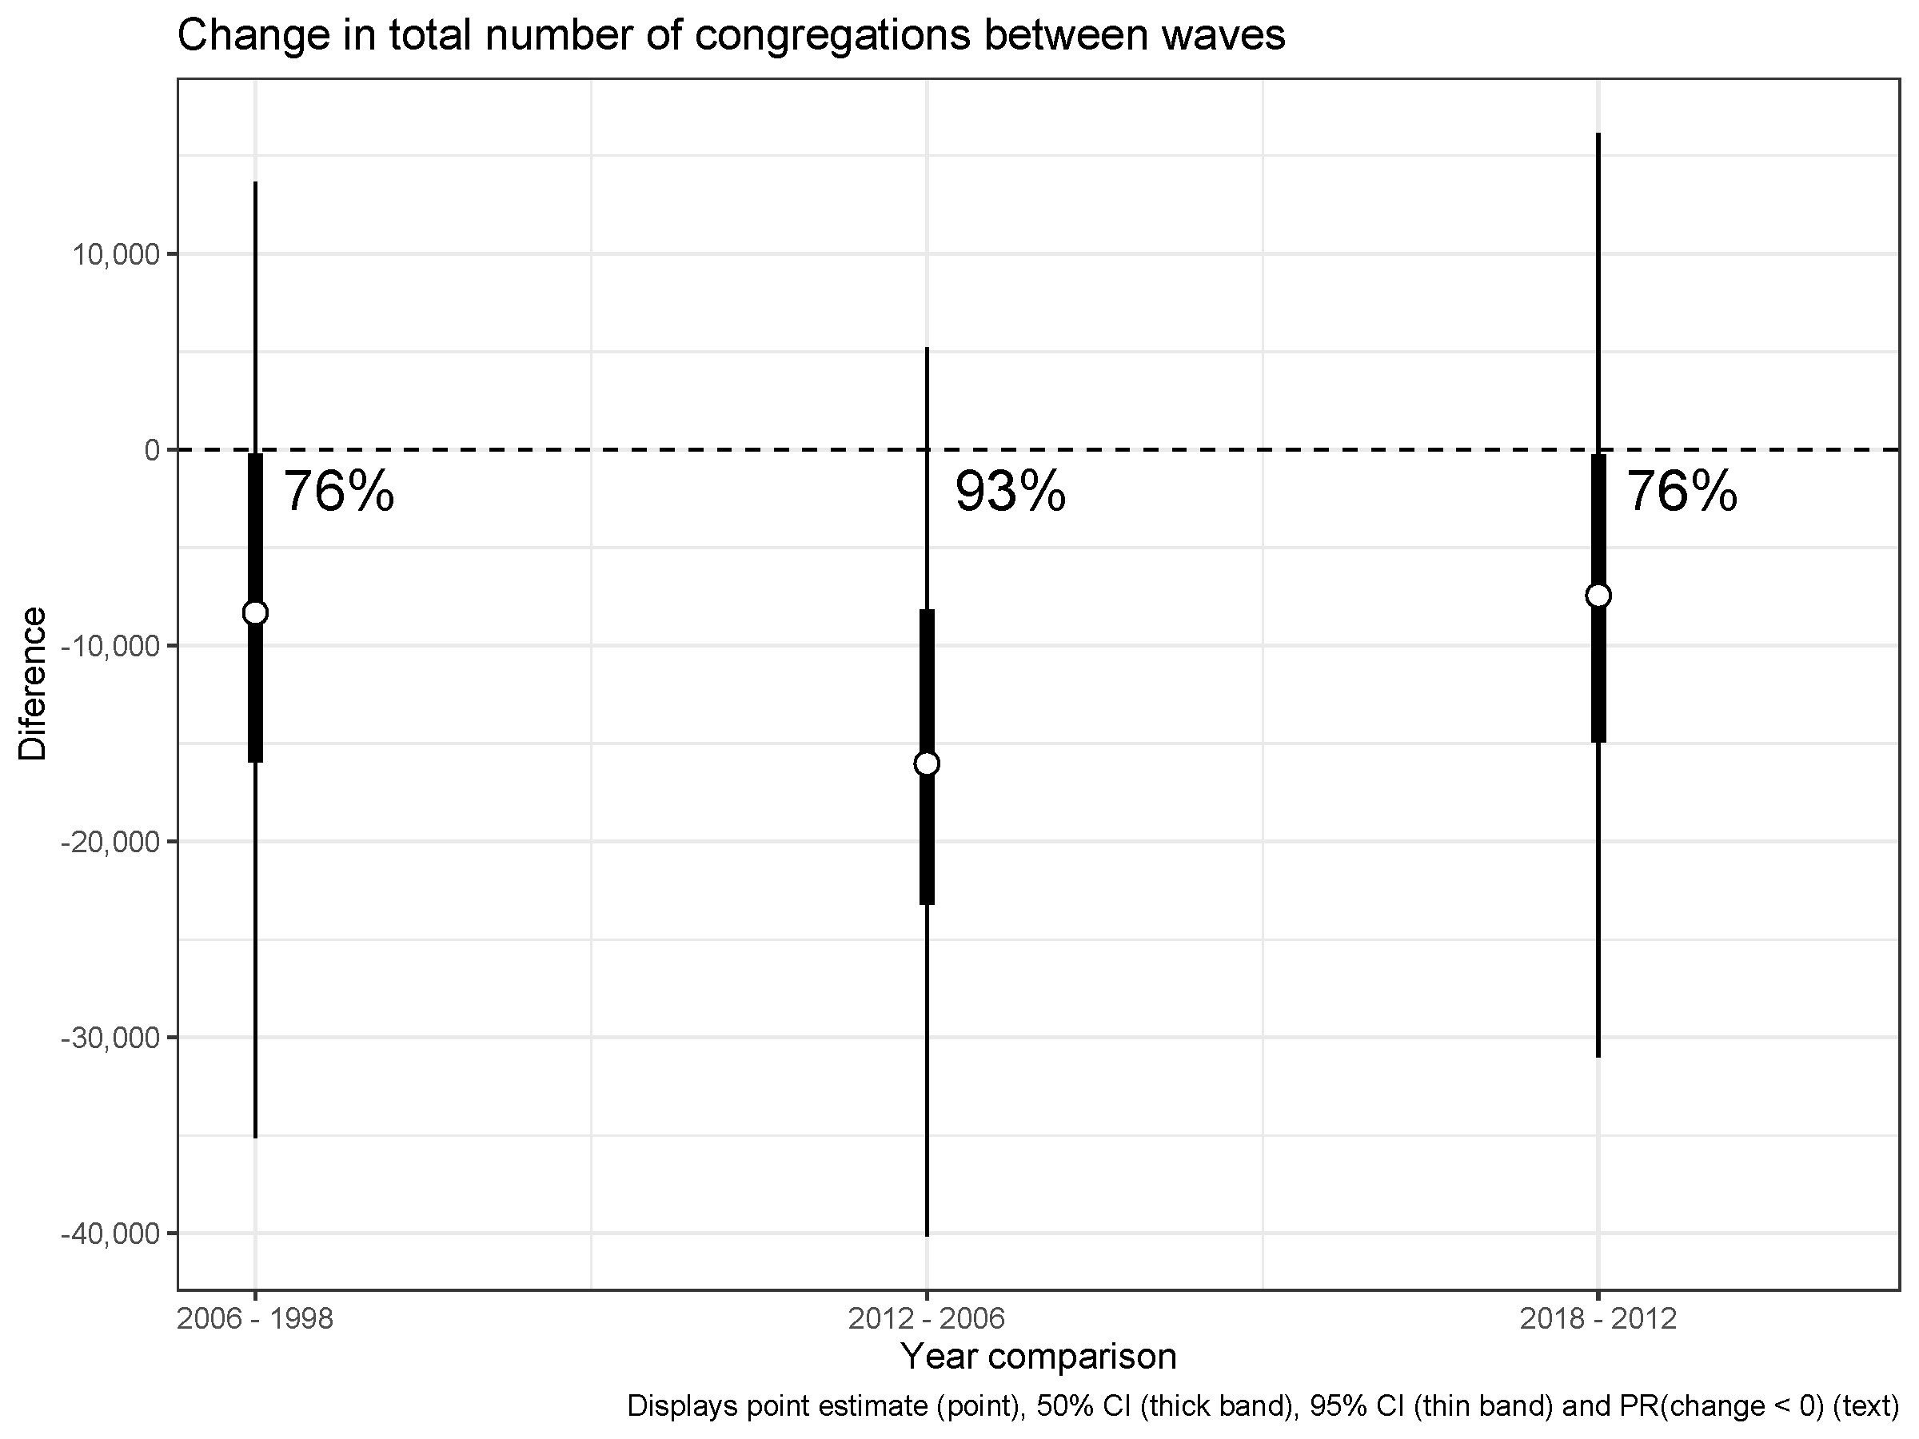
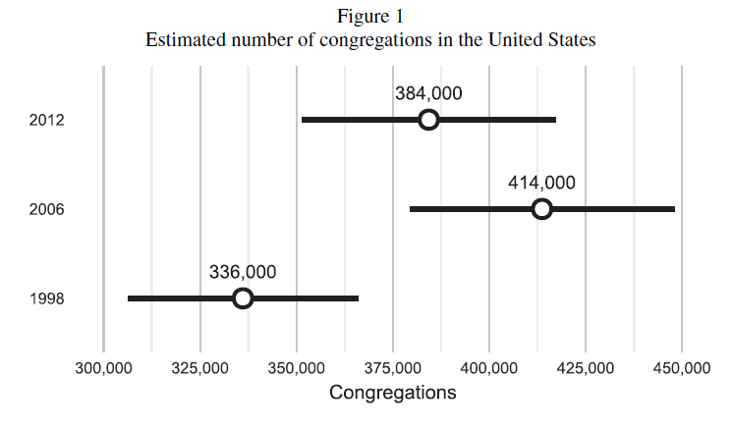
Brauer 2017 “How Many Congregations Are There?”

Slide 19
Congregations closed and opened

Slide 20
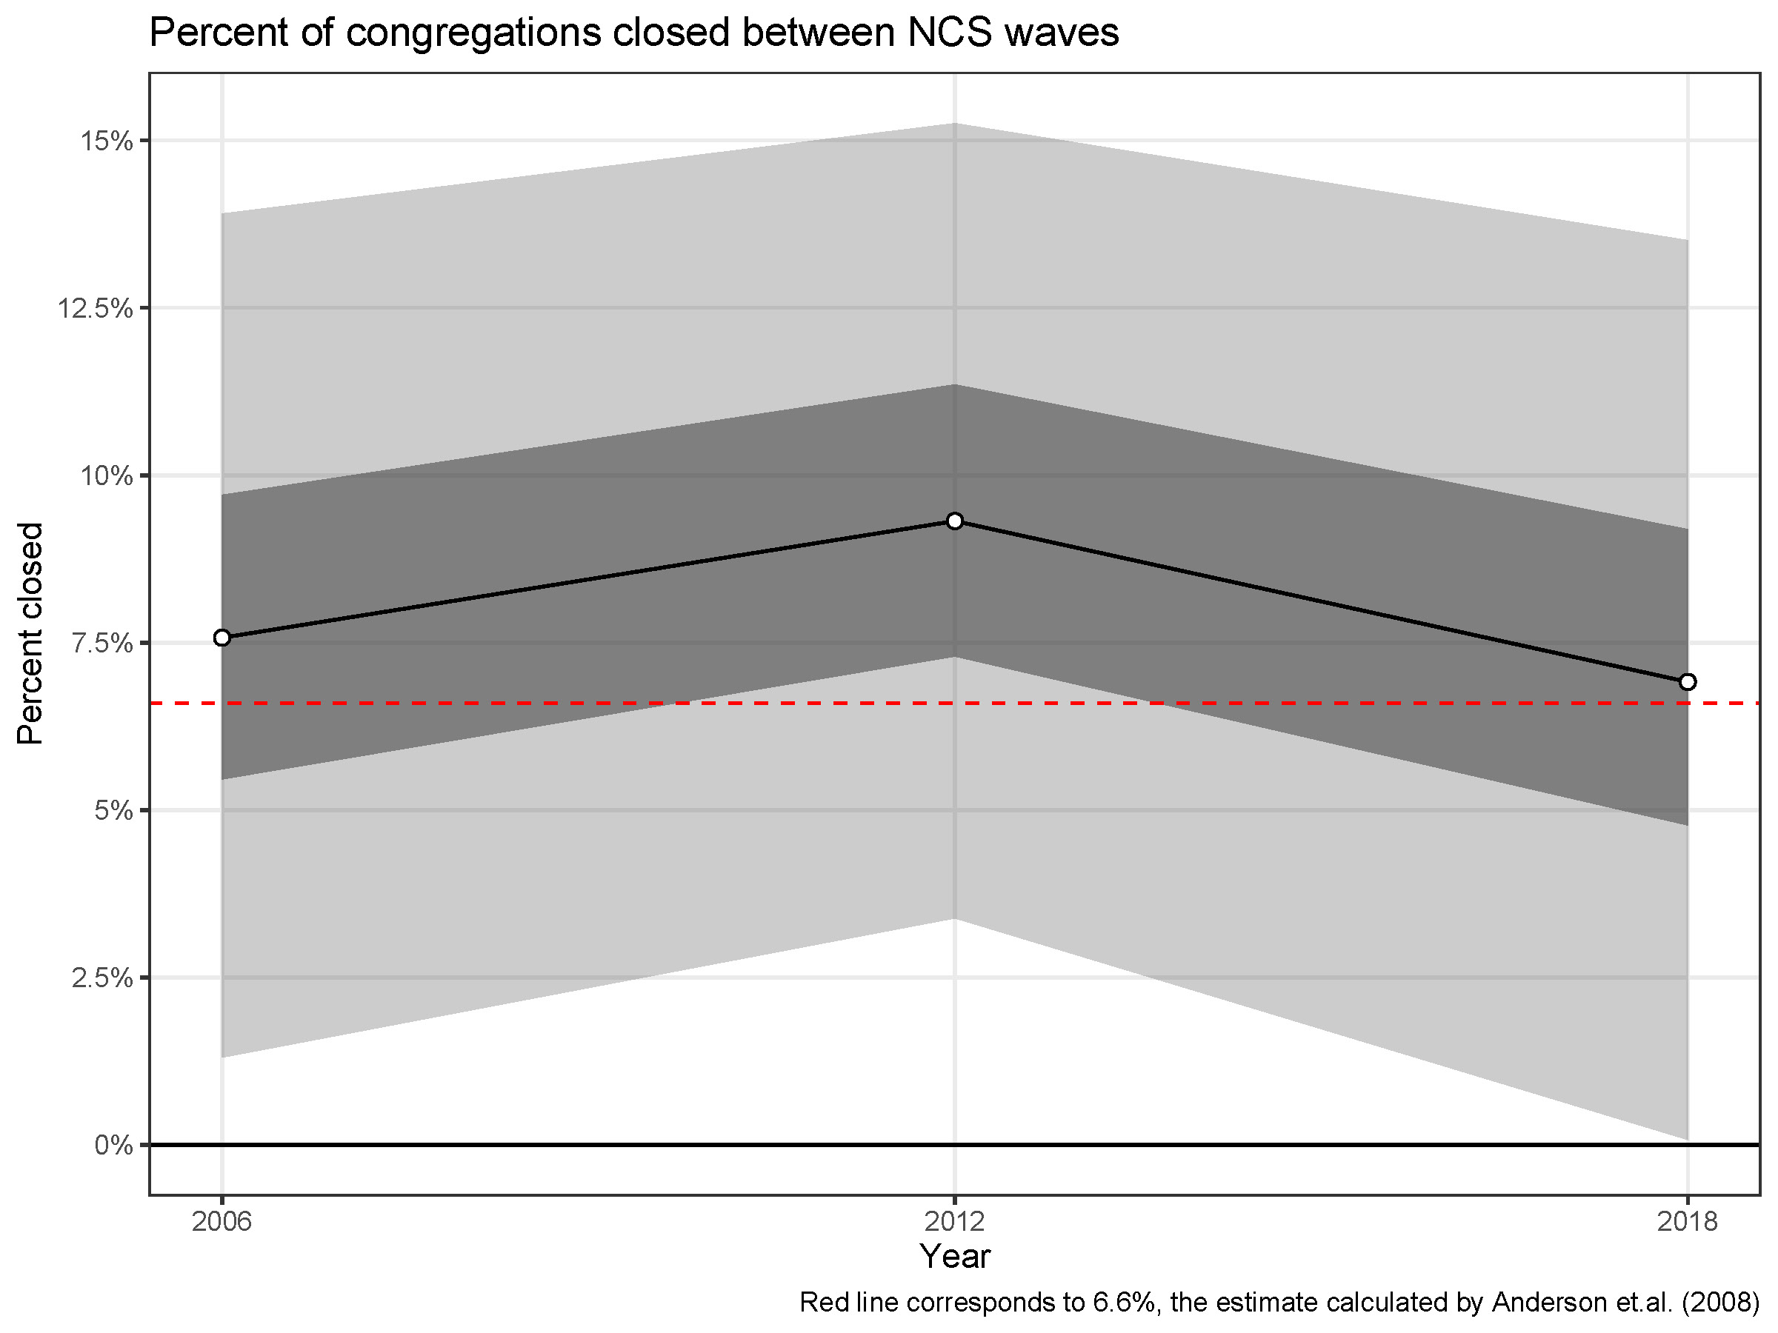
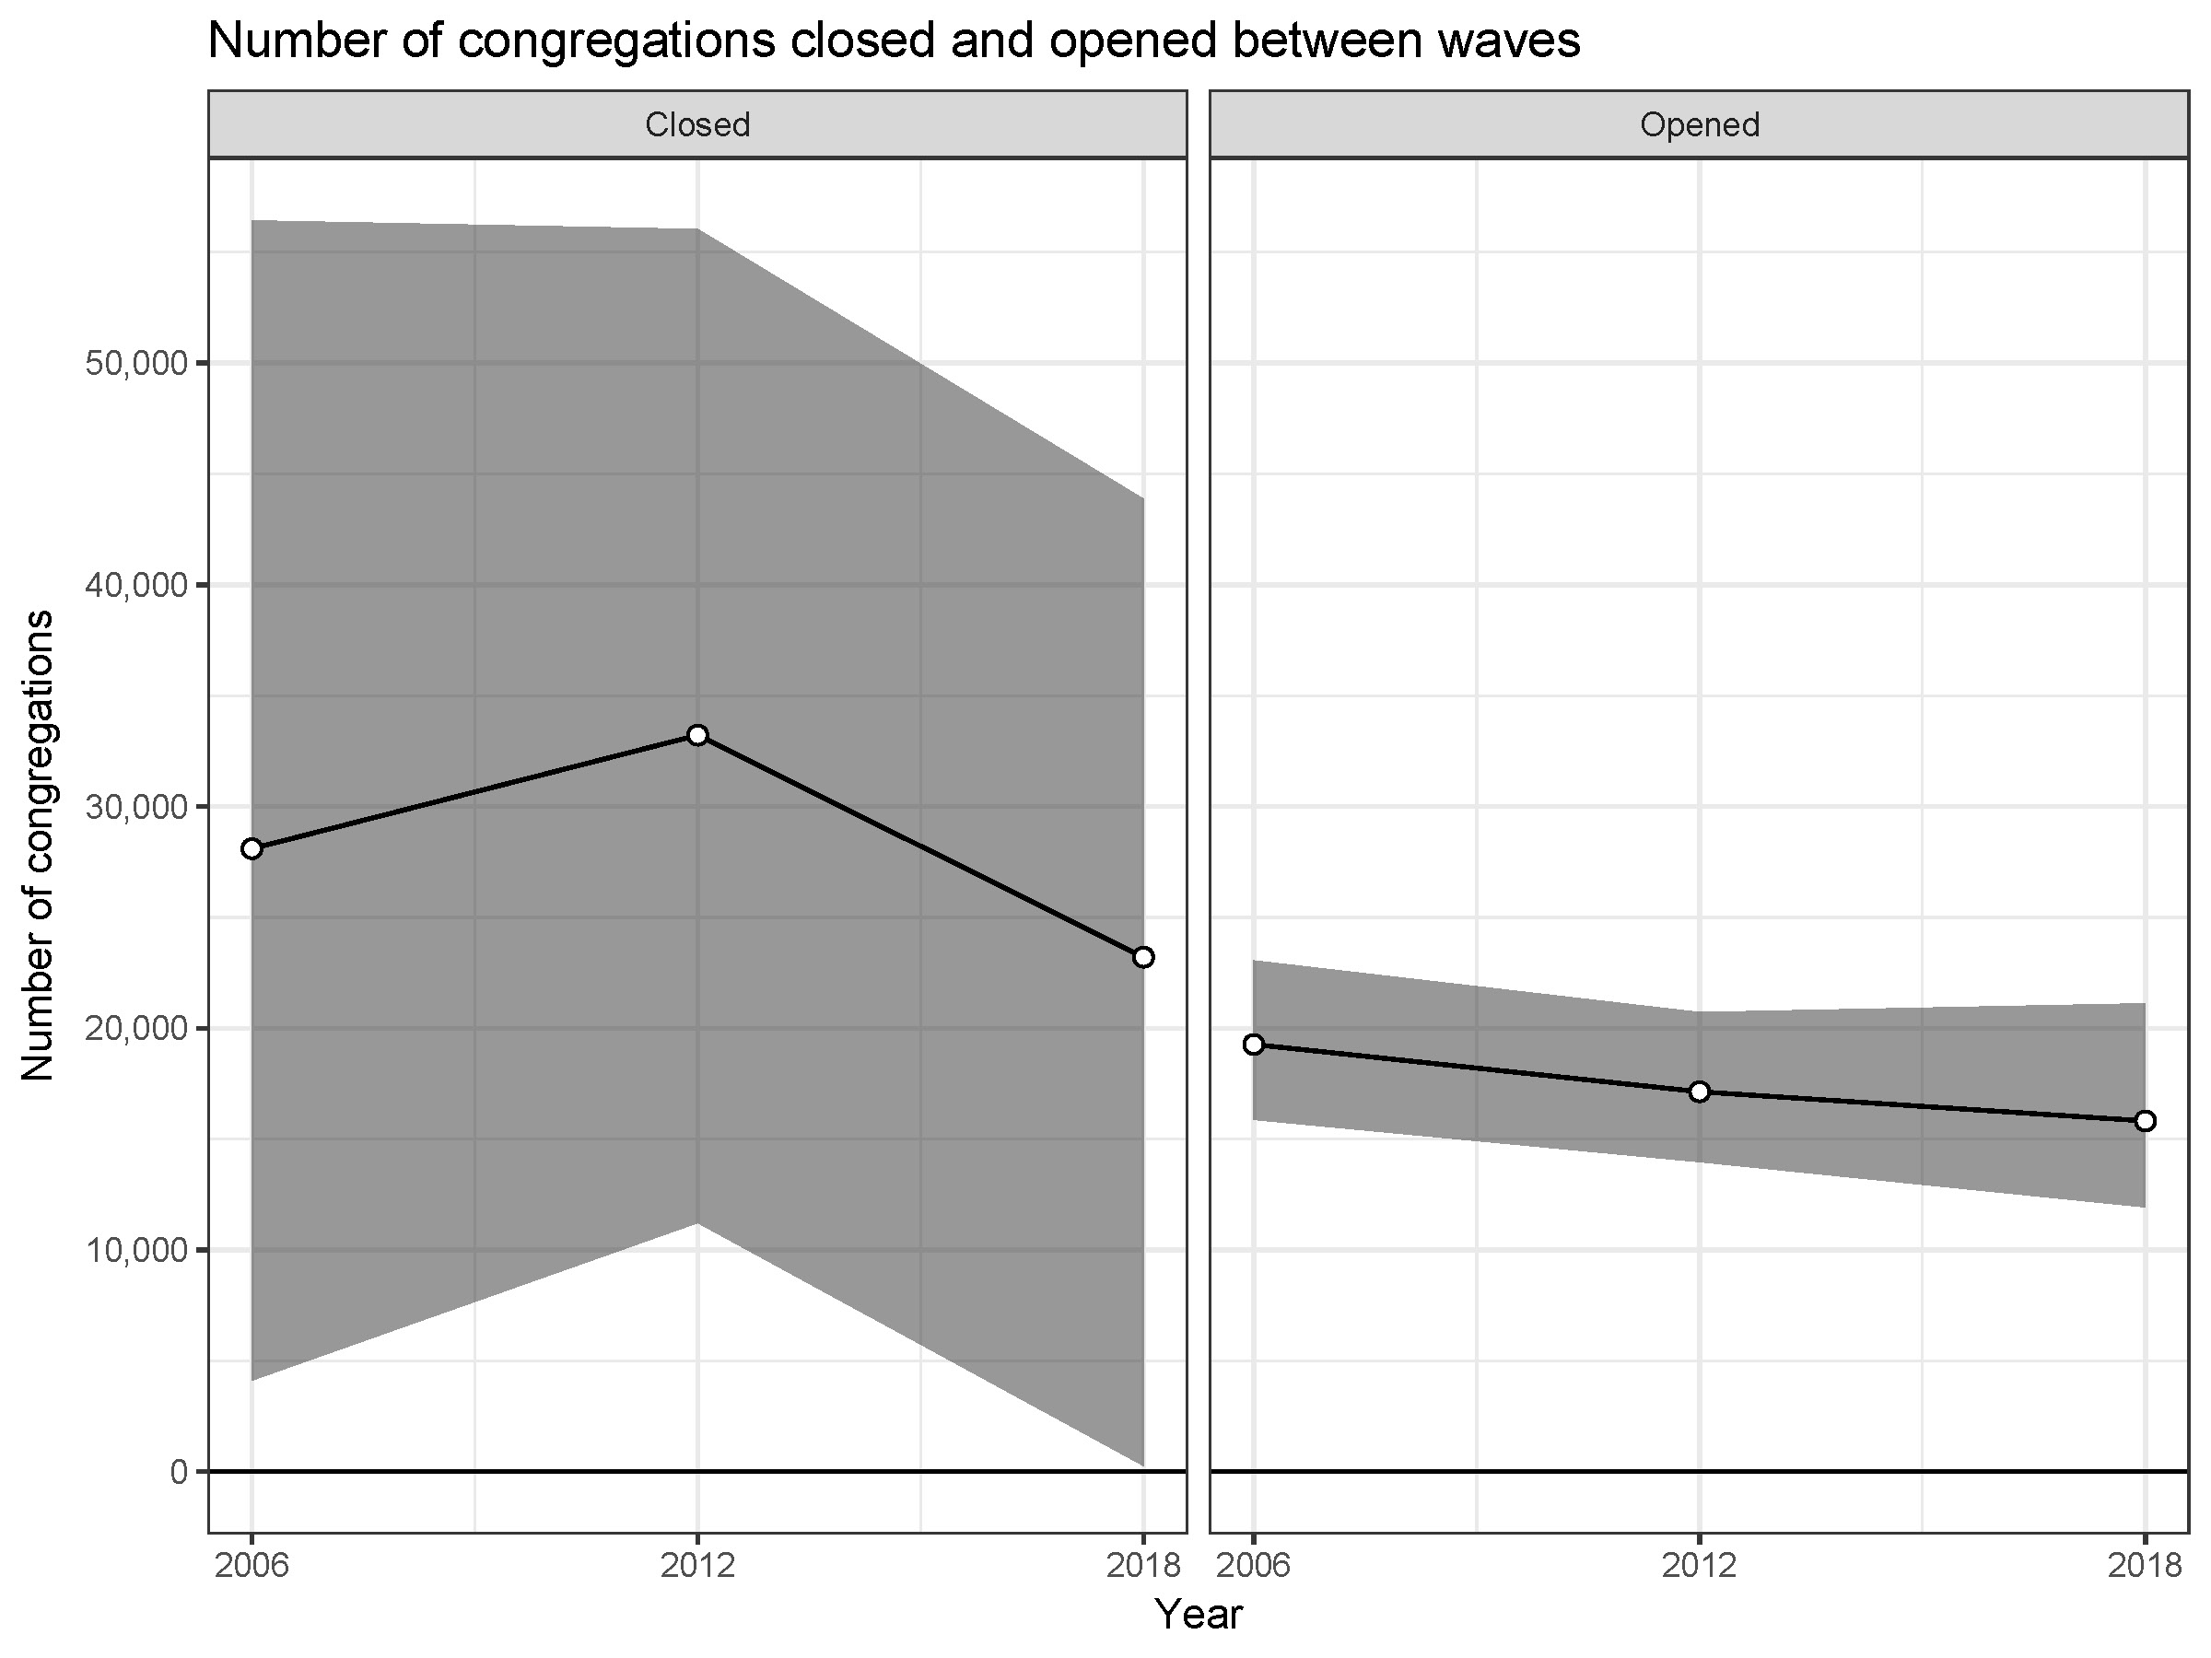

Slide 21
Supporting evidence and embarrassing anomalies

Slide 22
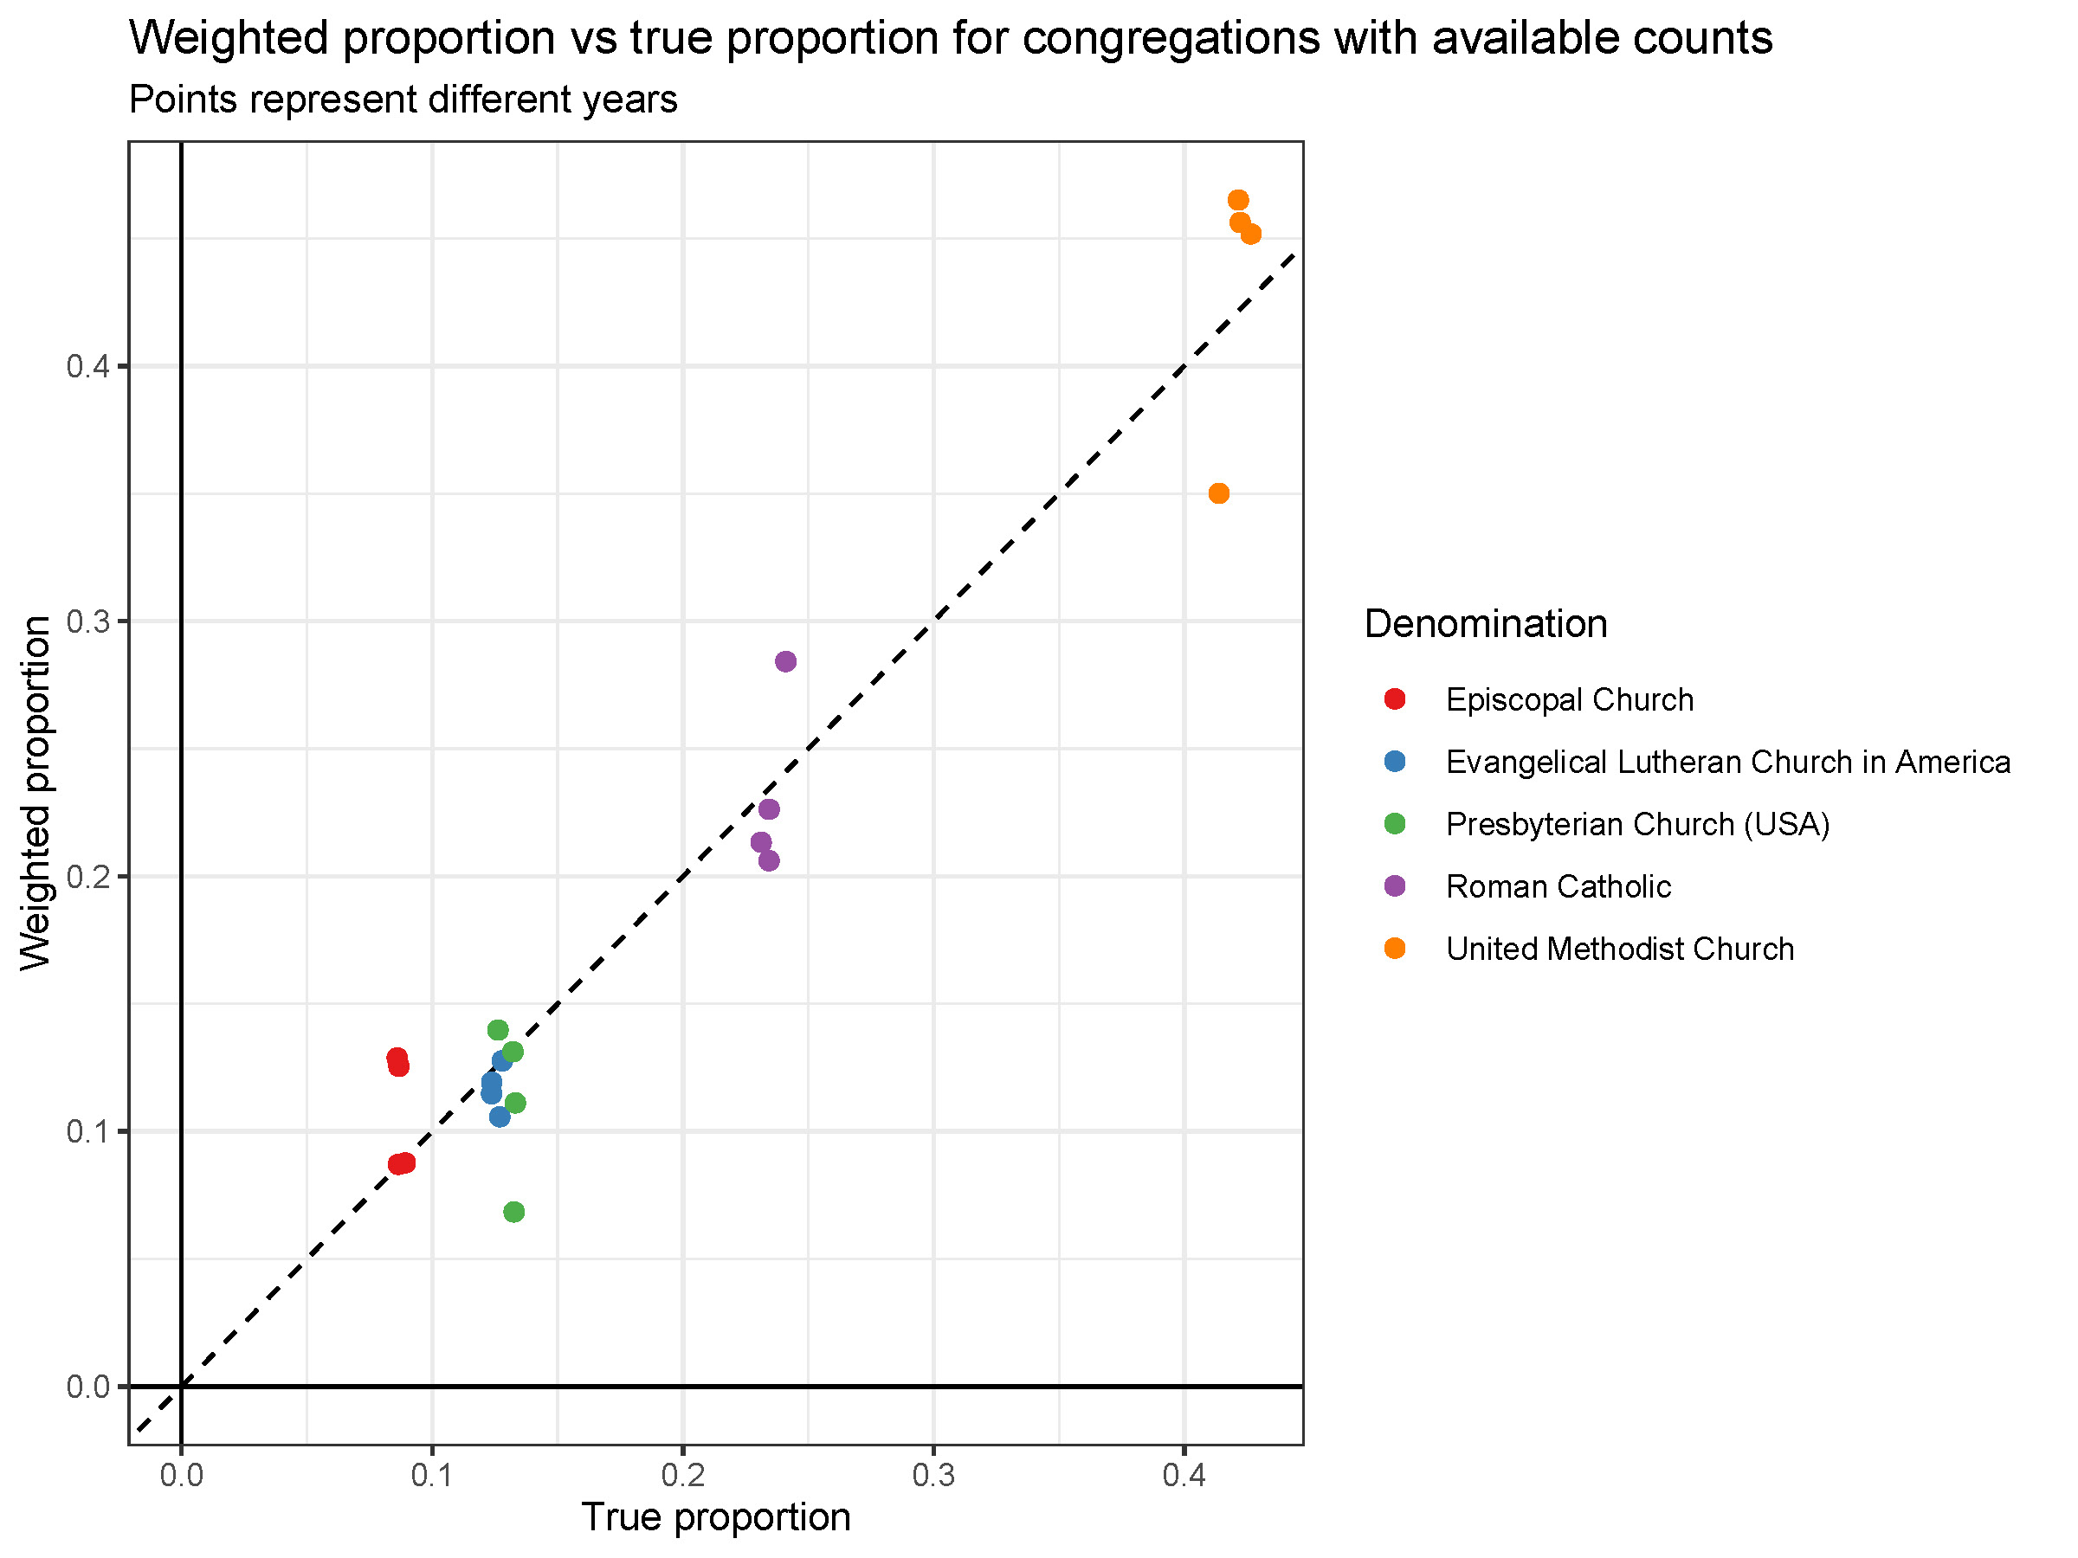
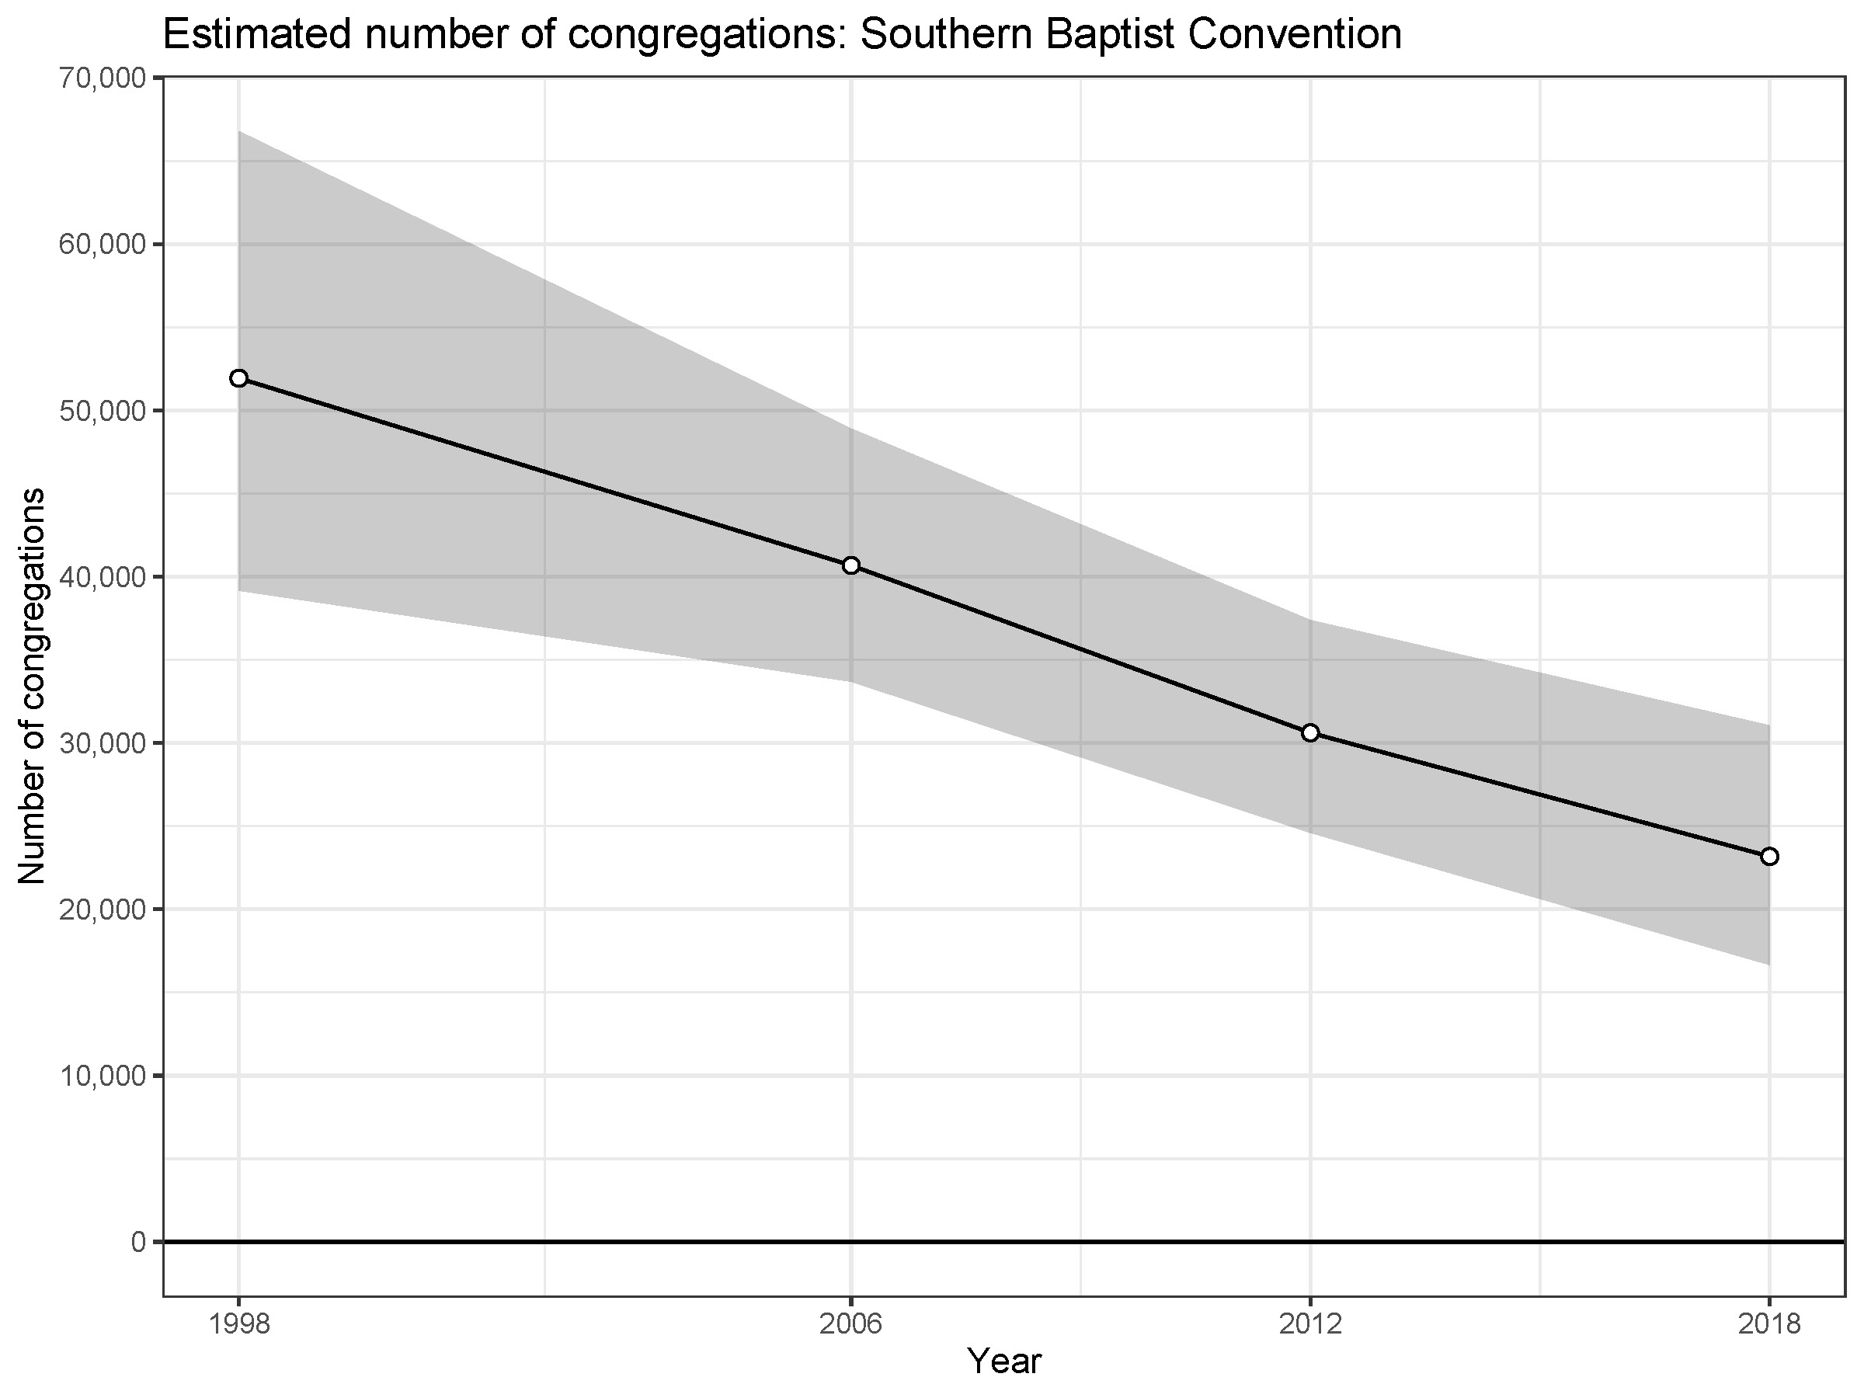
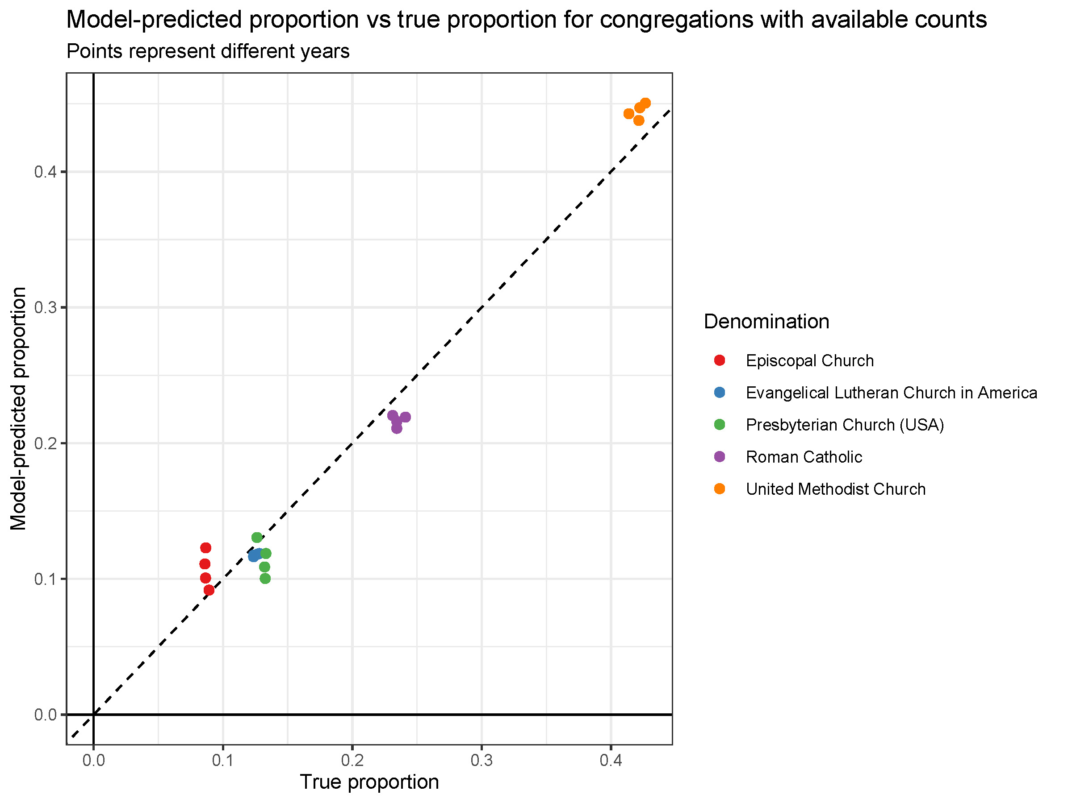
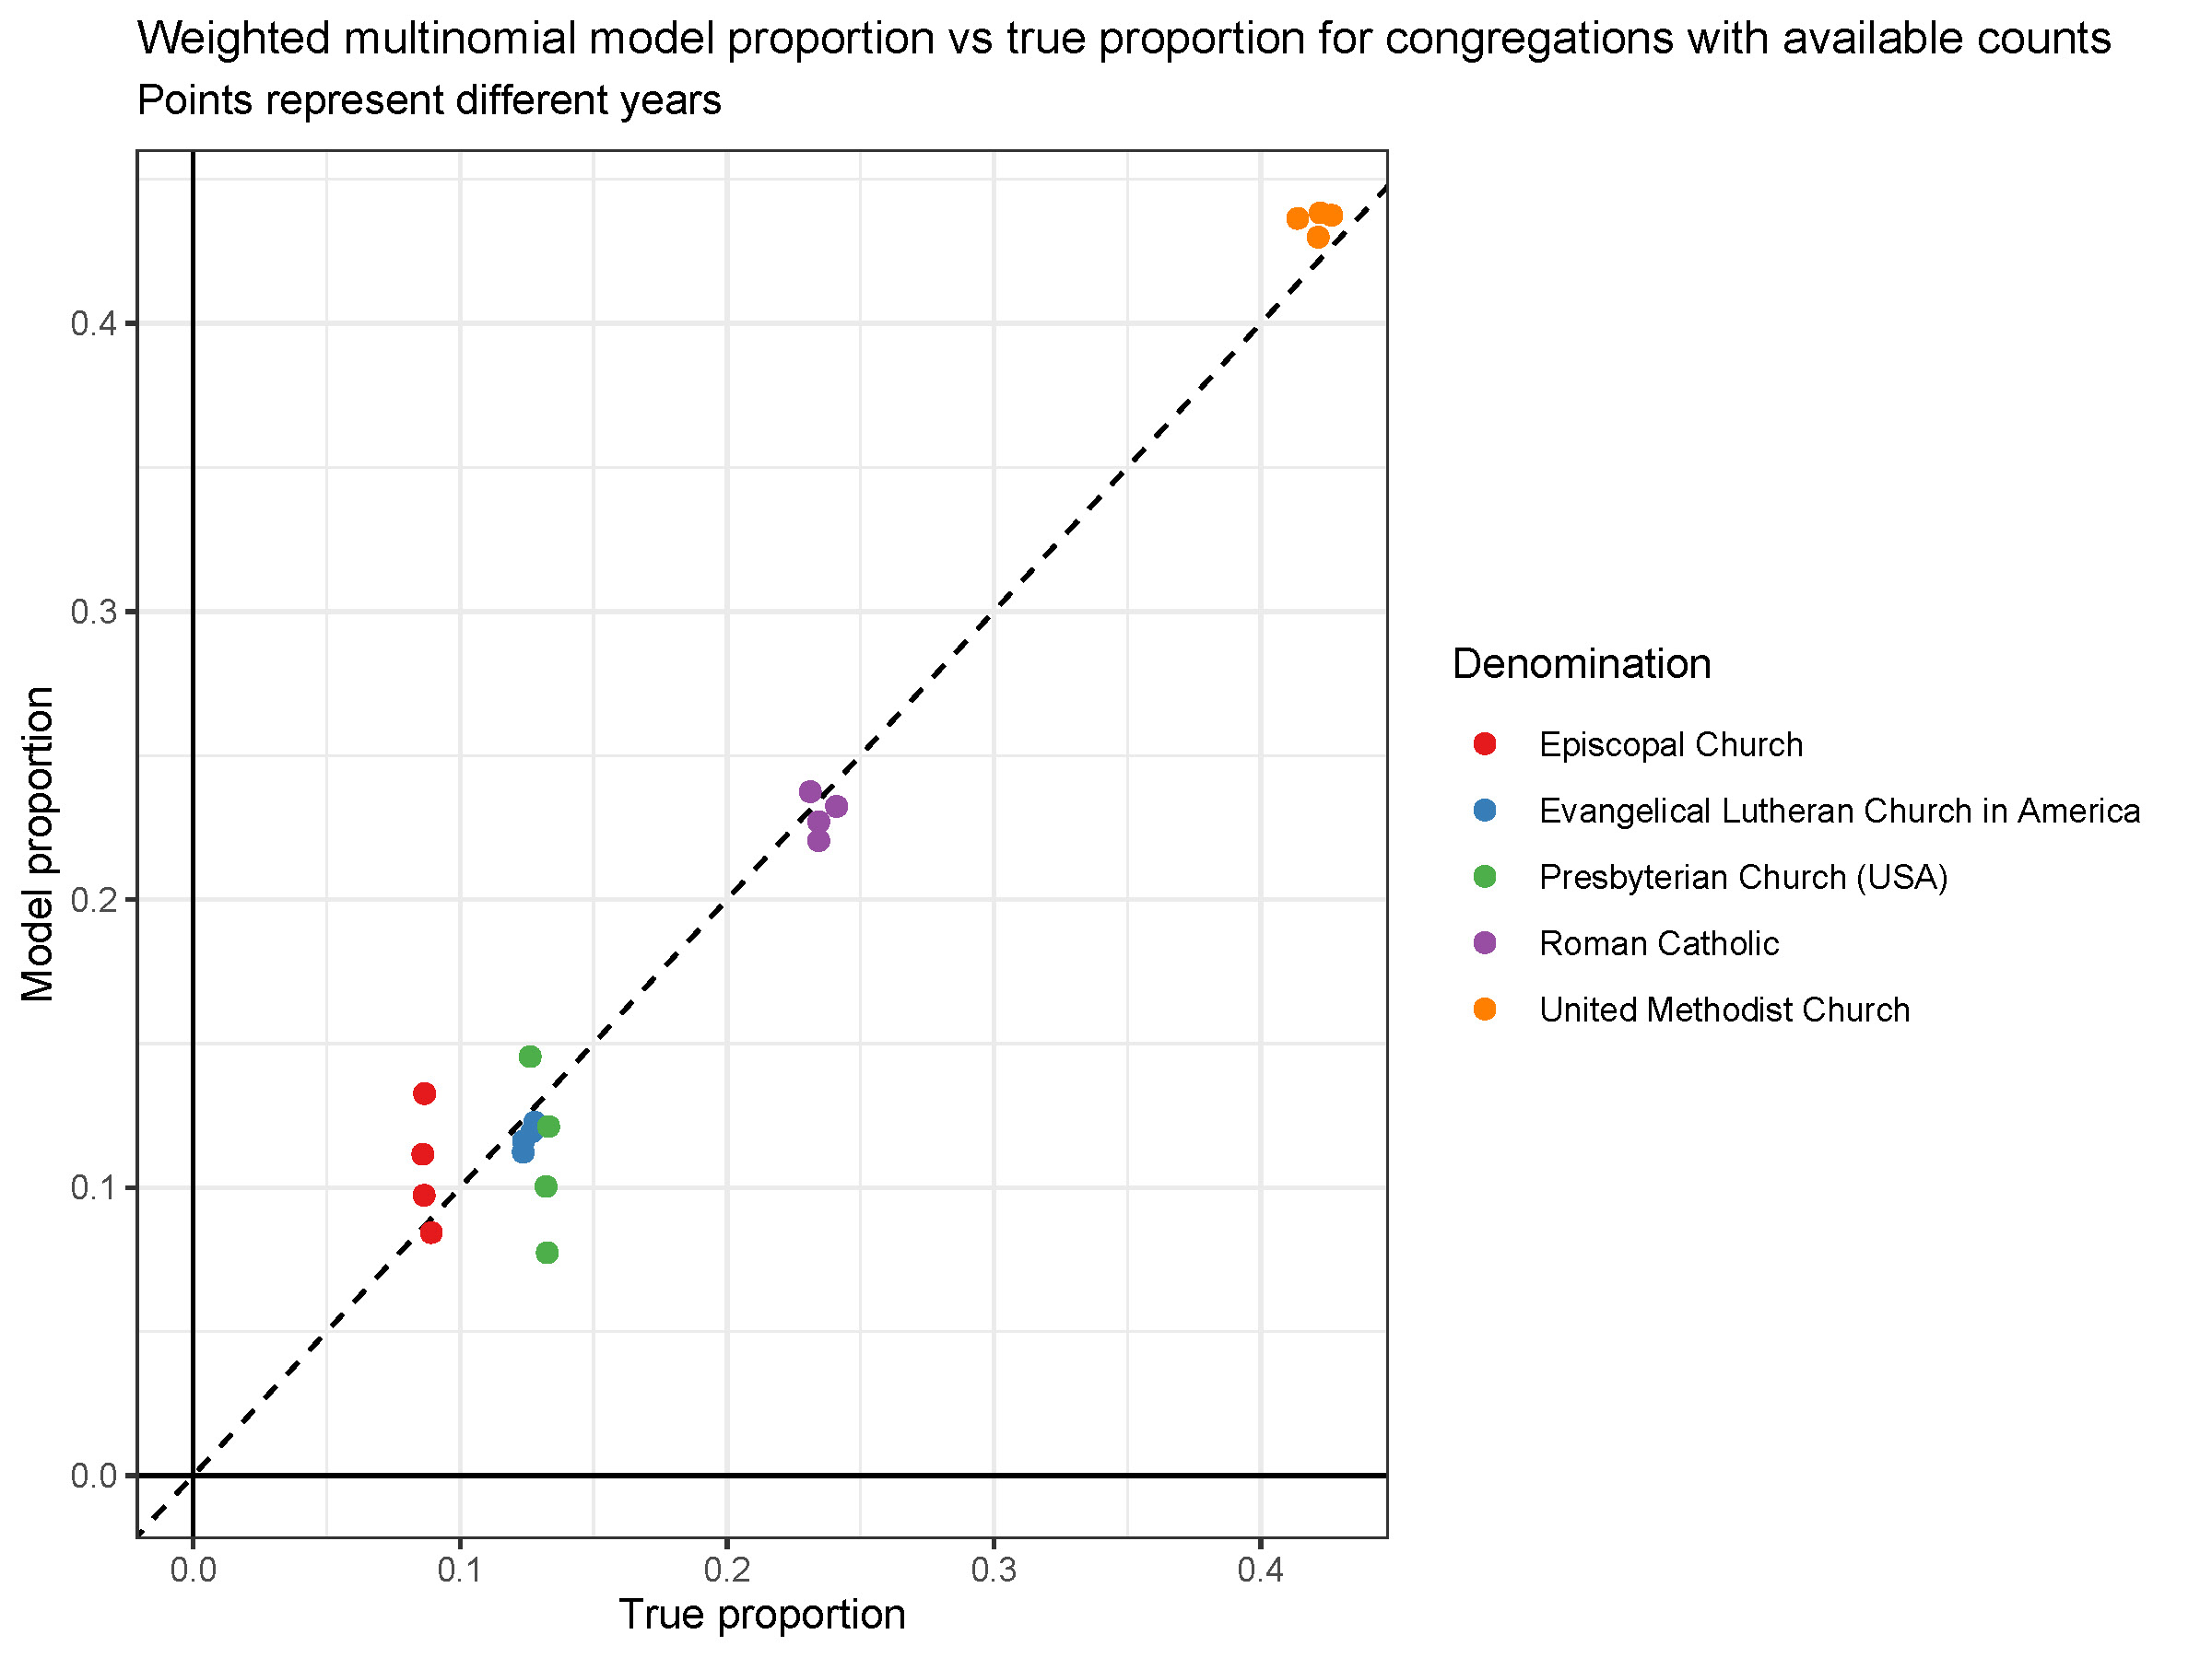

Slide 23
Advances and considerations
Group proportions (even of well-represented groups) are highly sensitive to variance in size distributions
Modeling
- grants power and flexibility
- can make assumptions more explicit
- can reveal weaknesses and limitations
We need external sources of validation to adjudicate between models

Slide 24
Thank you
sgbrauer@umich.edu
http://www.simonbrauer.us

Slide 25
Additional advantages (though not demonstrated here)
Can improve estimates by predicting the outcome with a smooth function of congregation size (Zheng and Little 2003)
Can improve size/outcome predictions with additional information from the respondents
Can post-stratify to respondent-level cells to improve estimates
If reported congregation sizes are “correct”, then you can infer the total number of congregations in the population without external data… otherwise, you can estimate the miscalibration

Slide 26
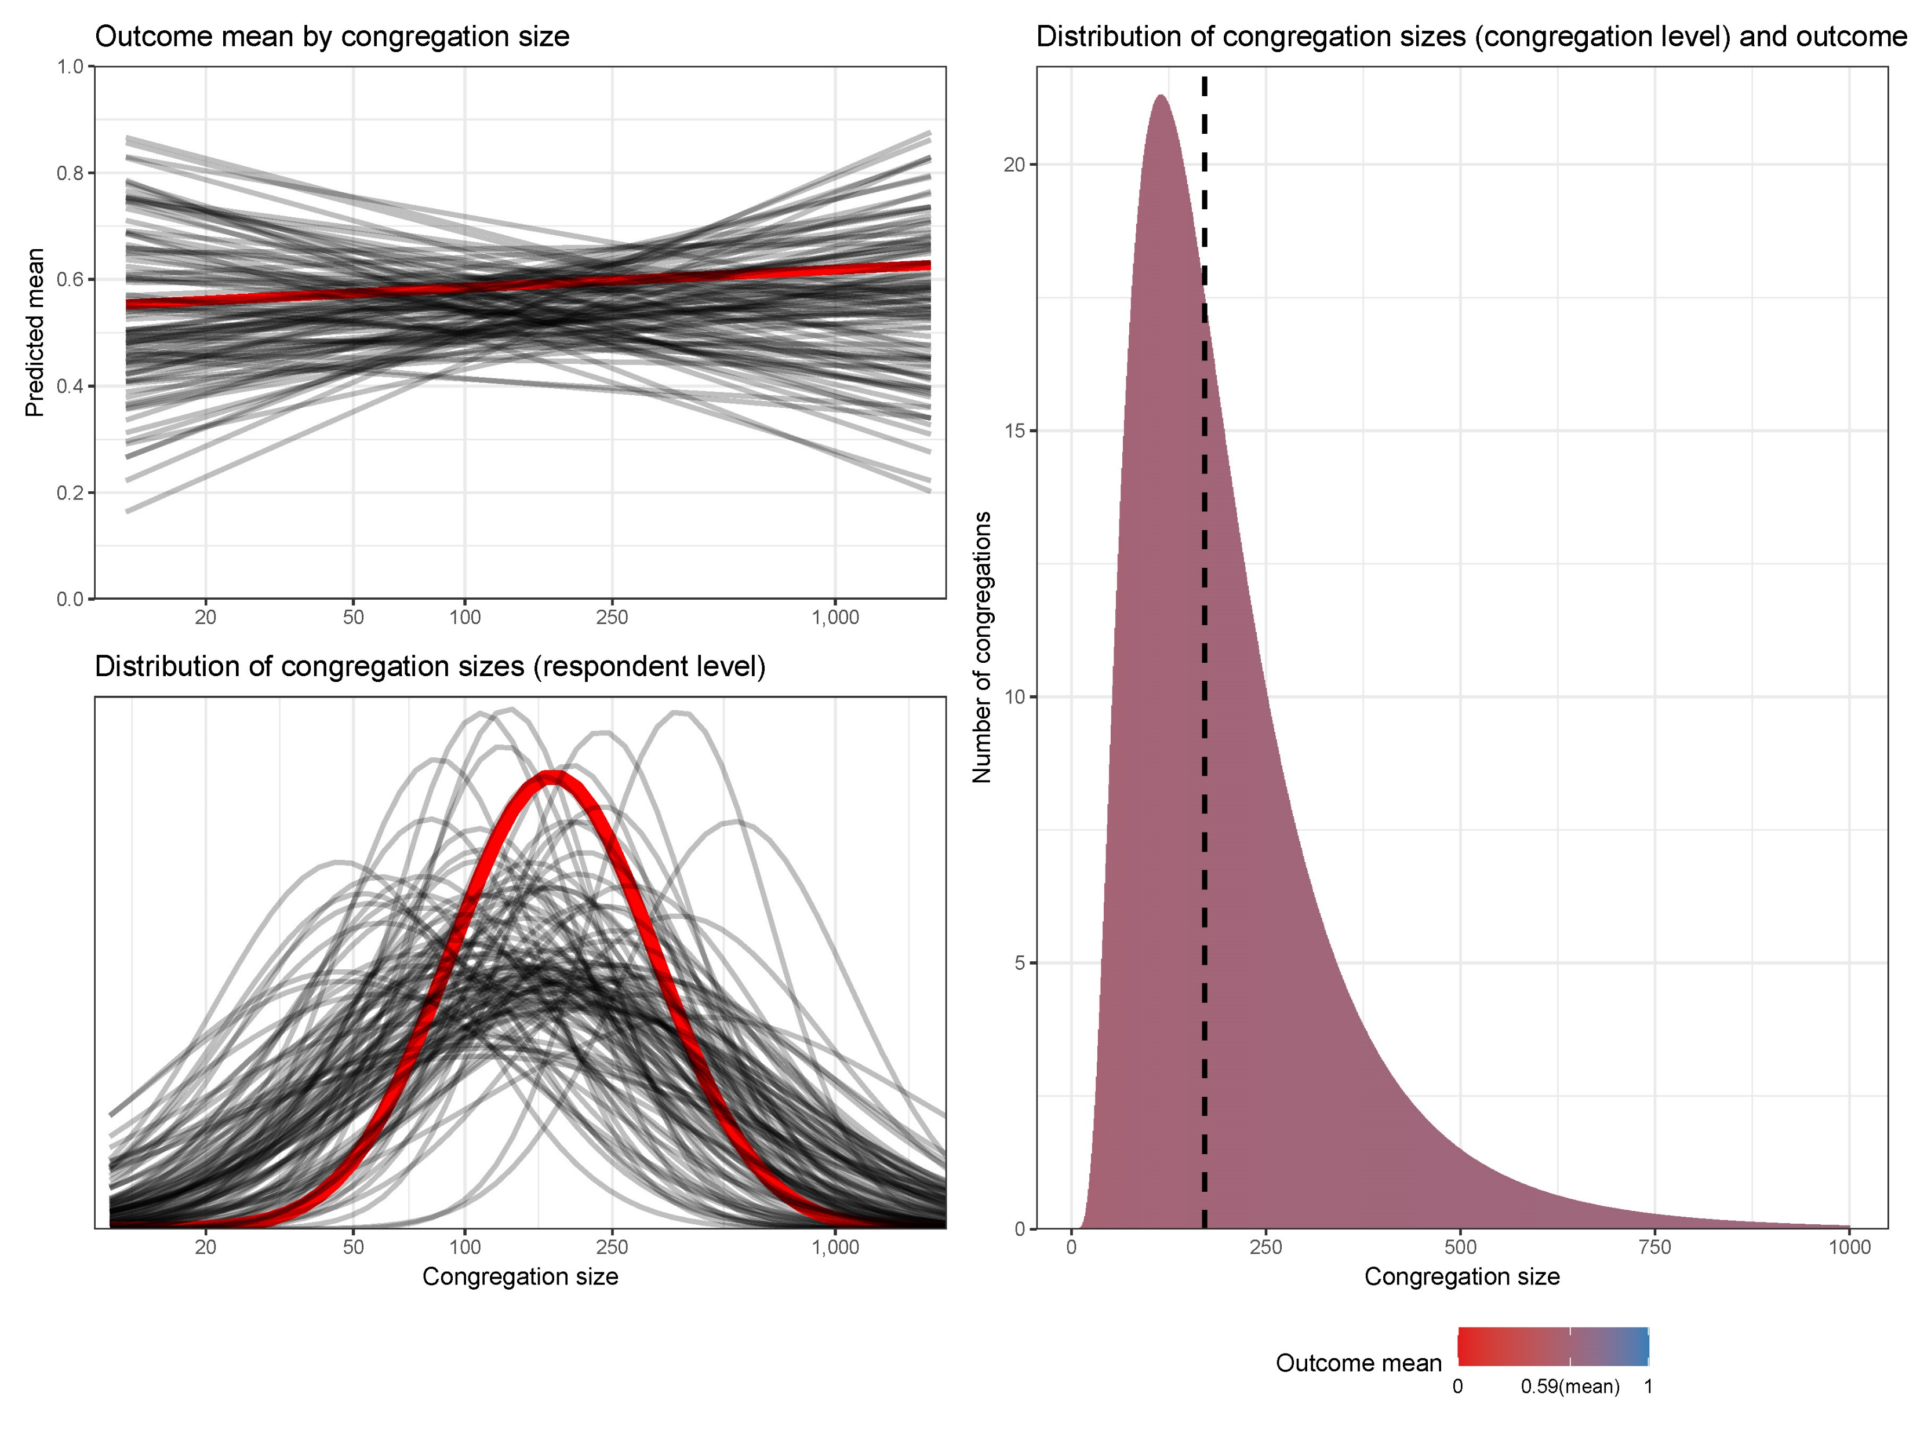
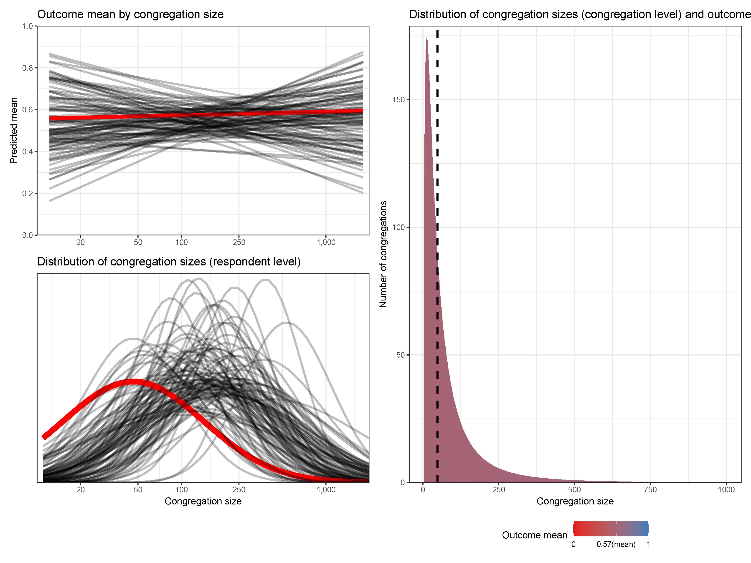
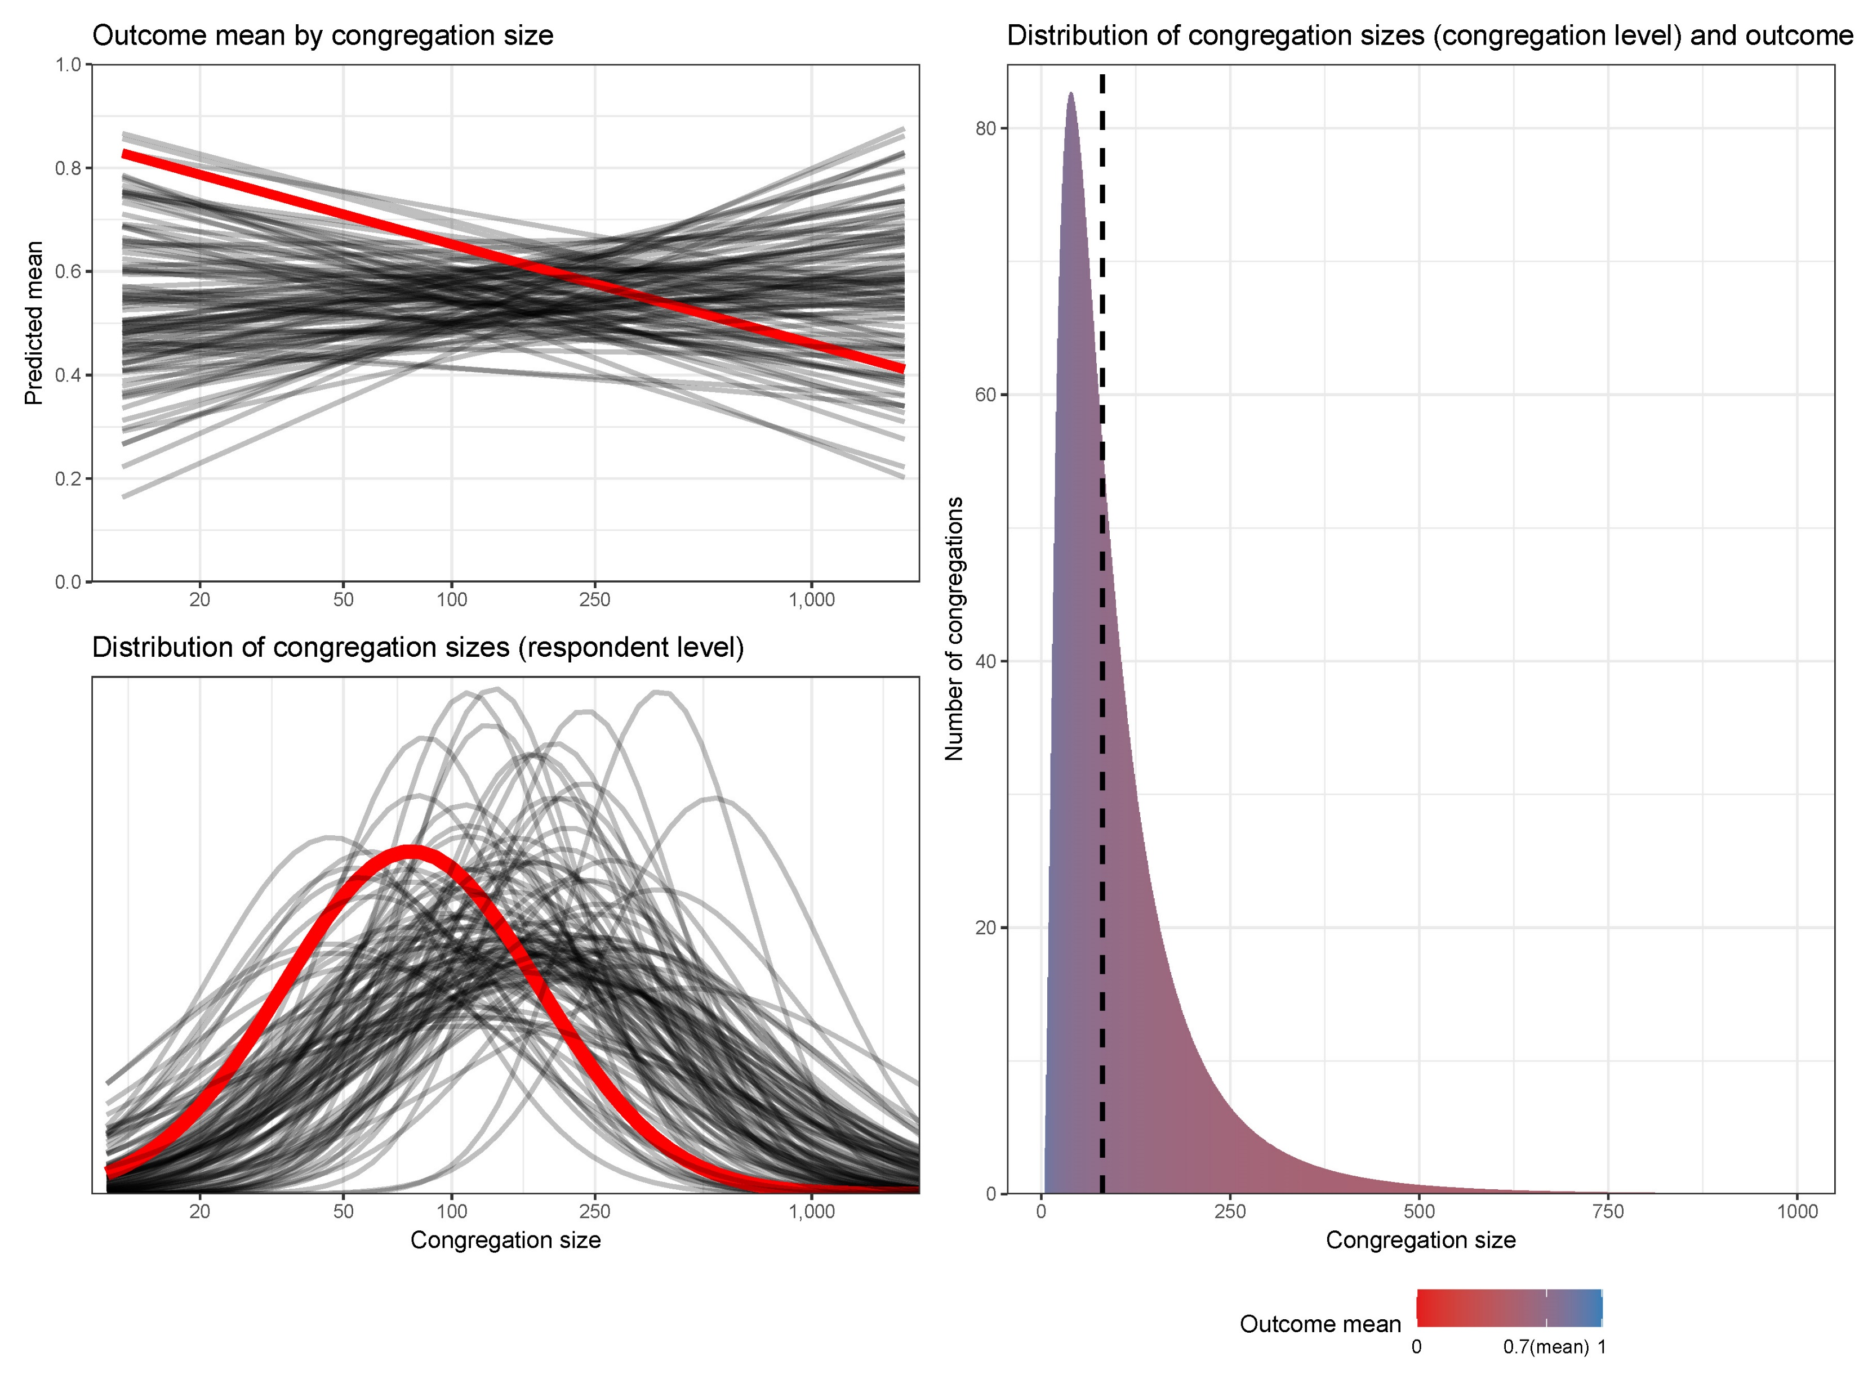
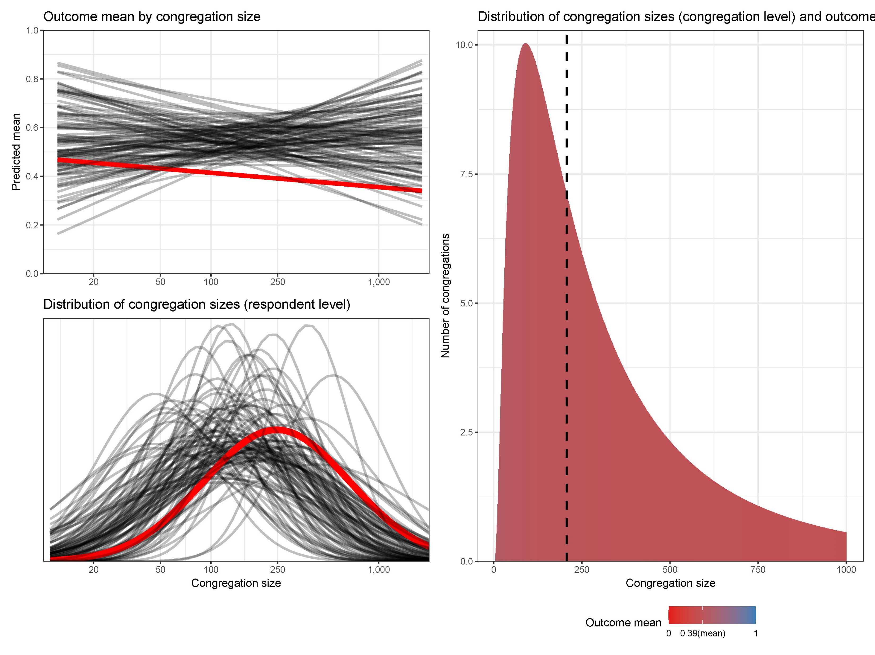
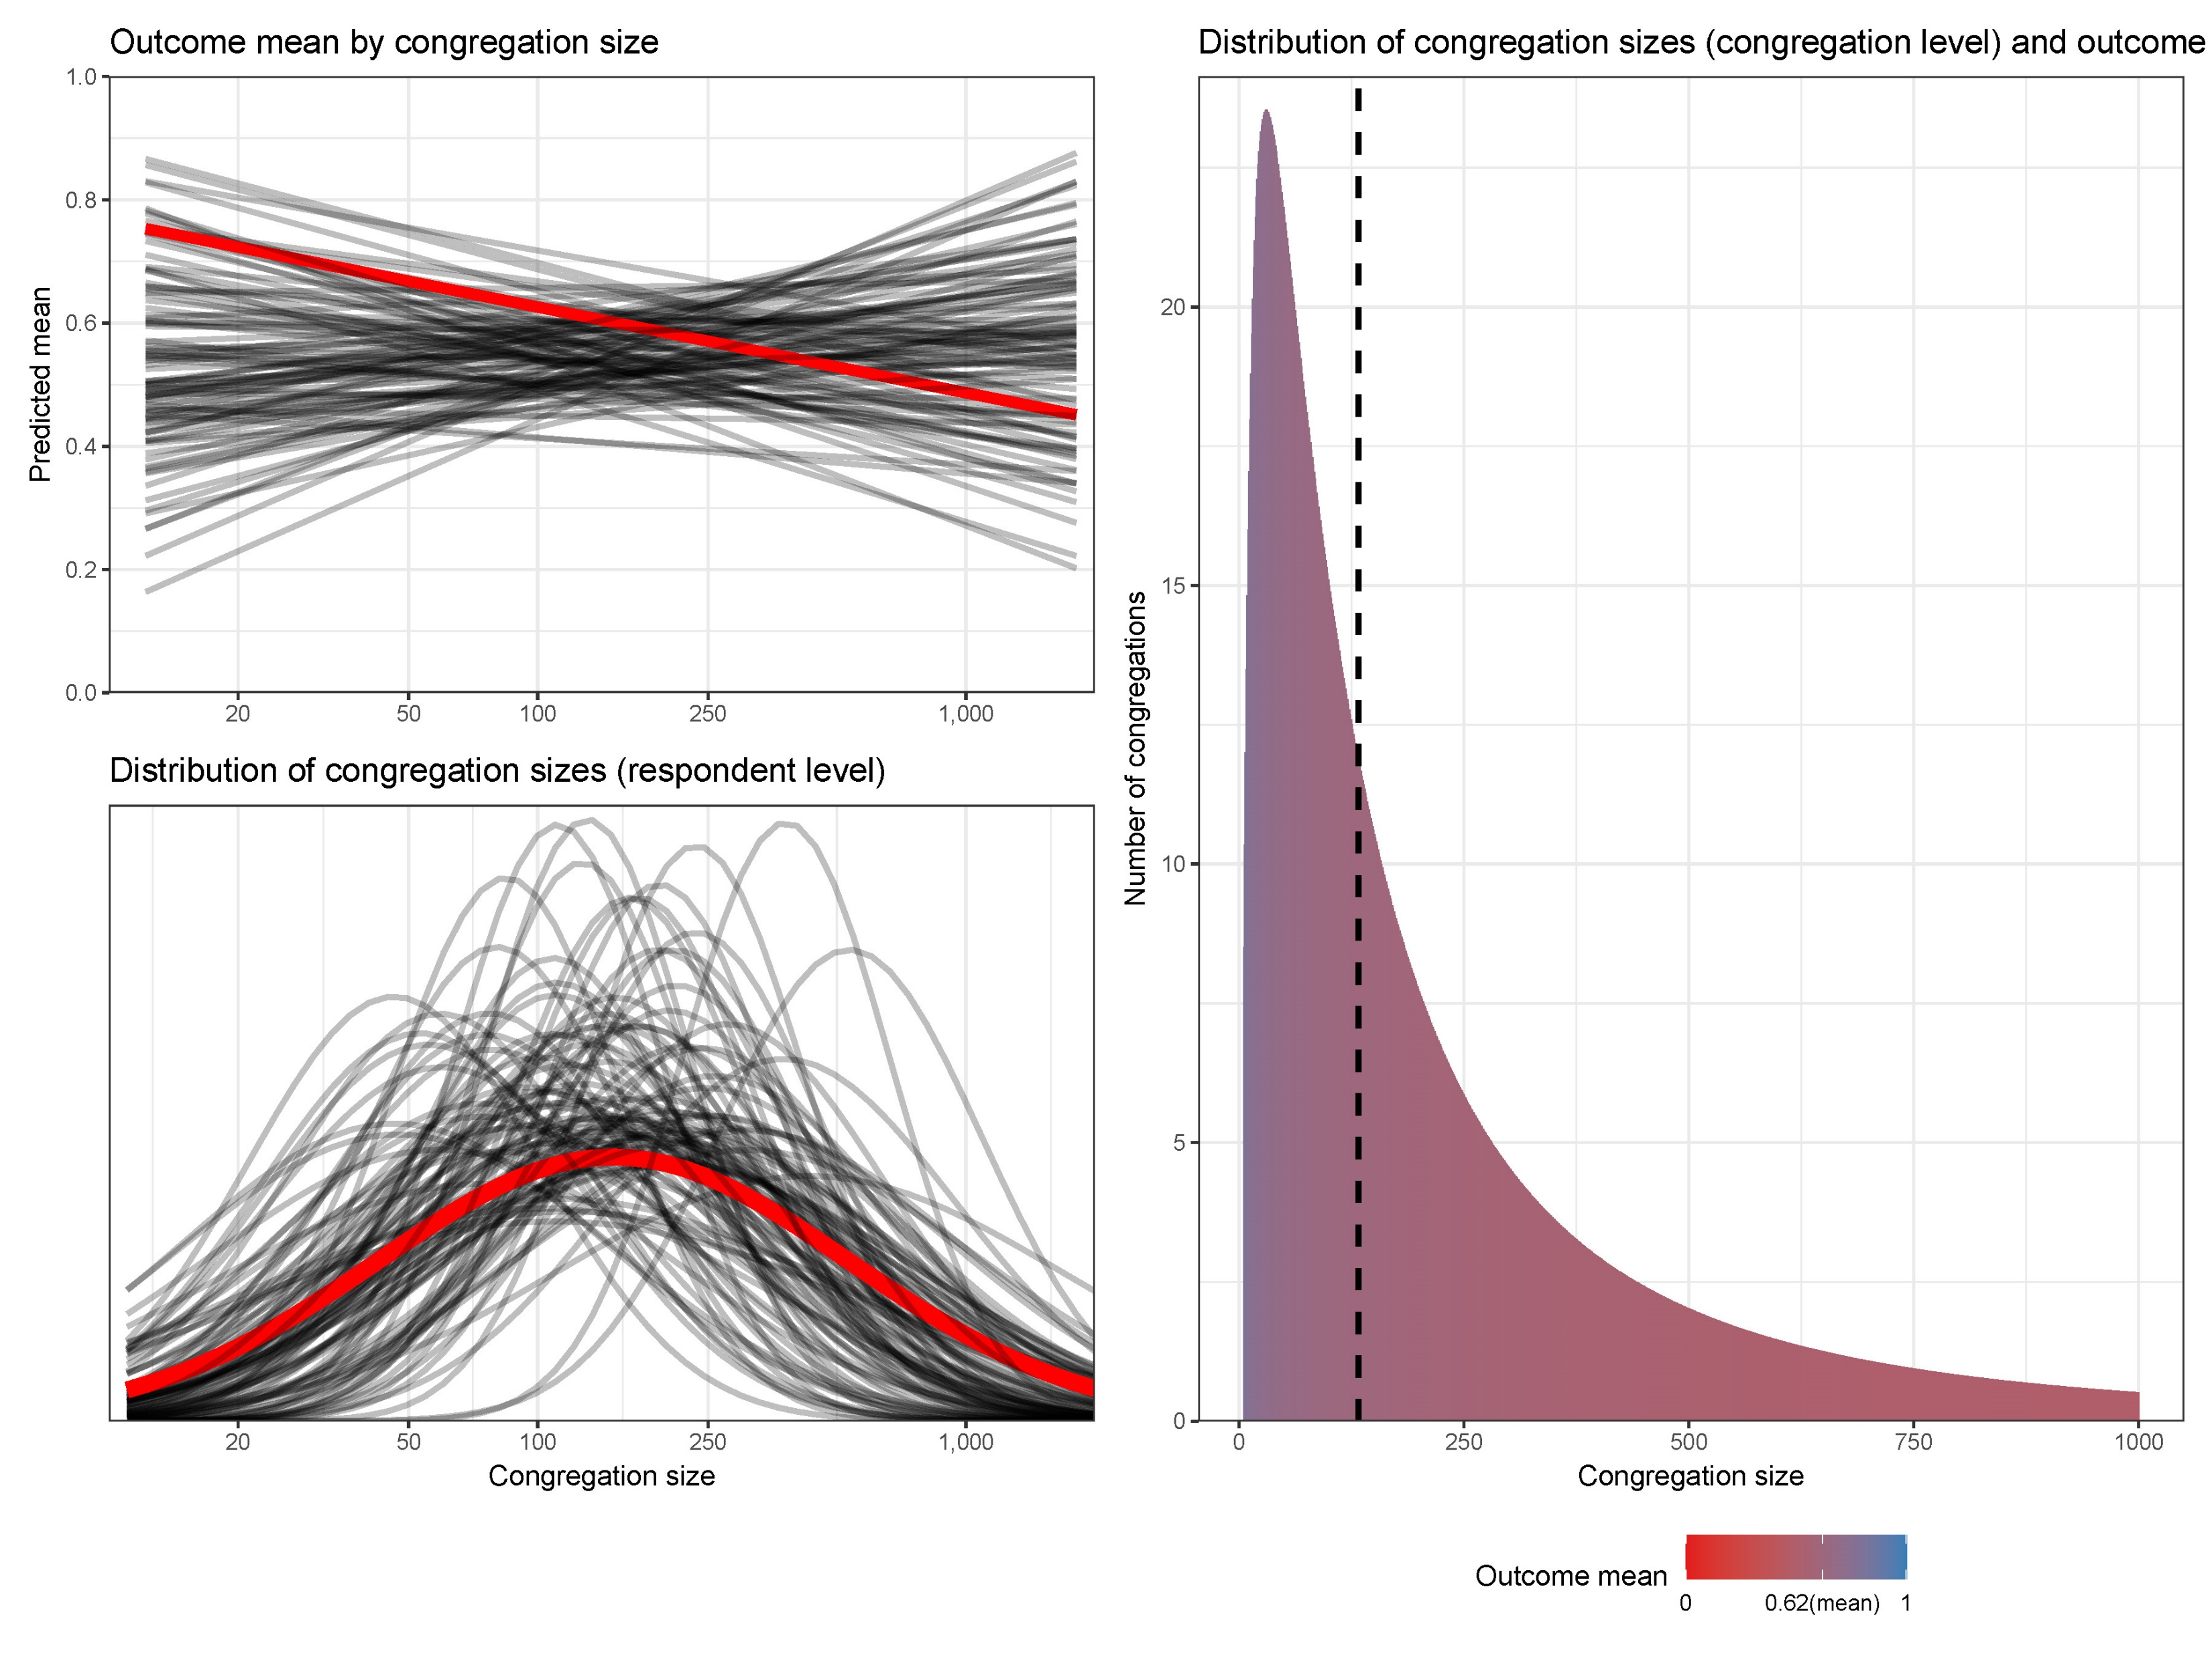
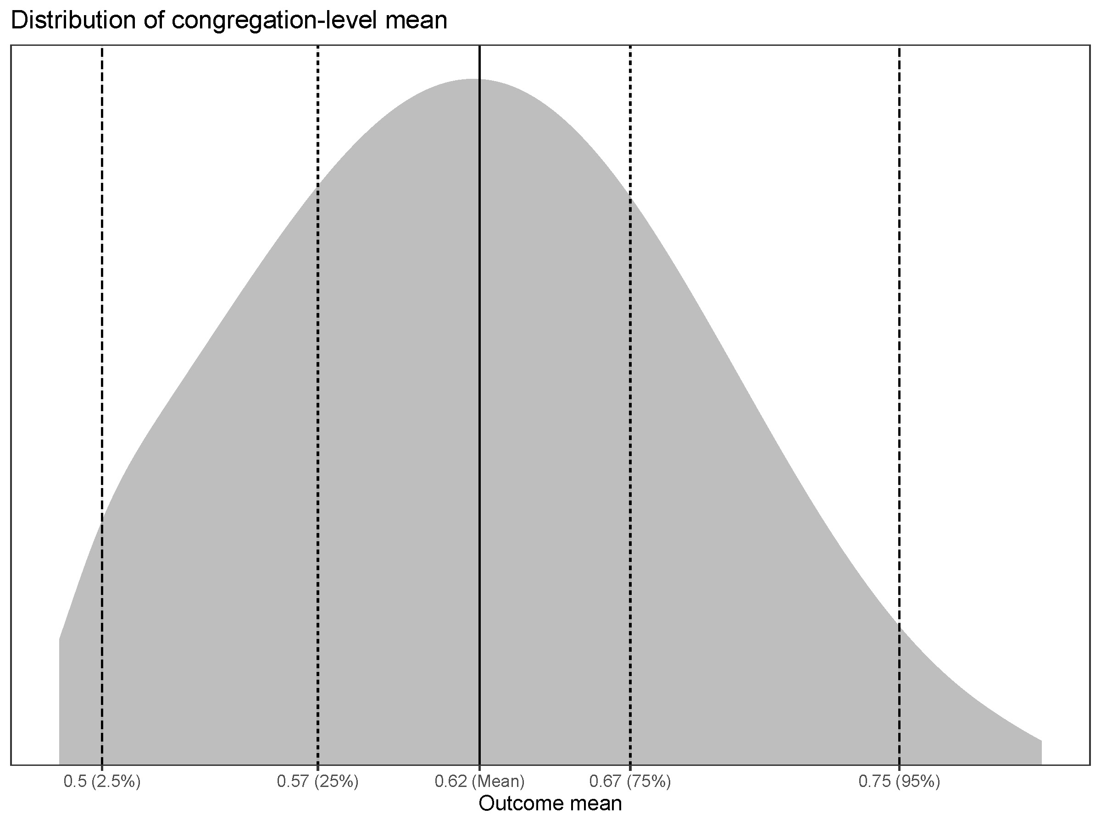

Slide 27
Denomination size distributions
Do the size distributions approximate the sample distributions (at the respondent level)?
i.e. is the model doing a good job at predicting size?

Slide 28
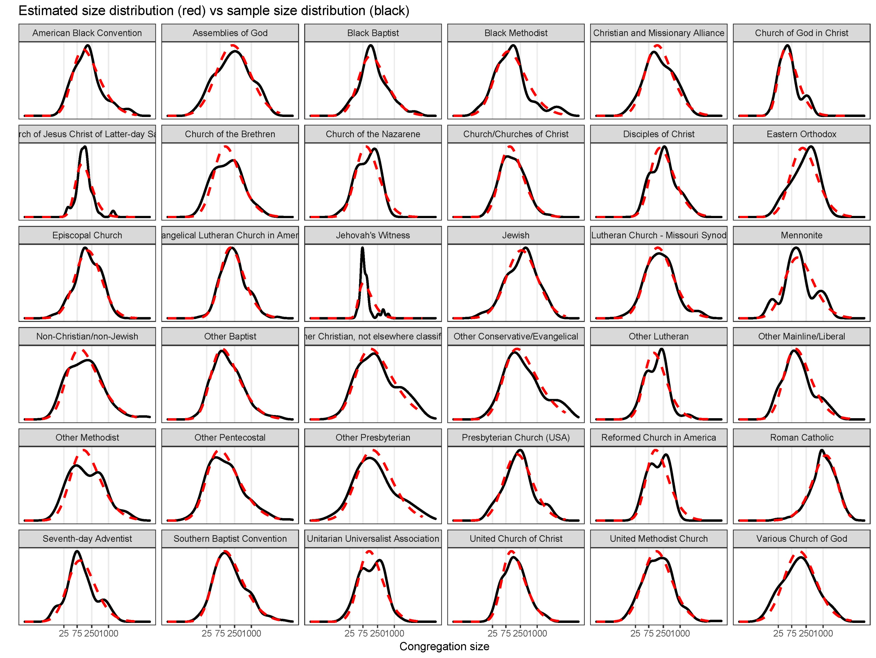

Slide 29
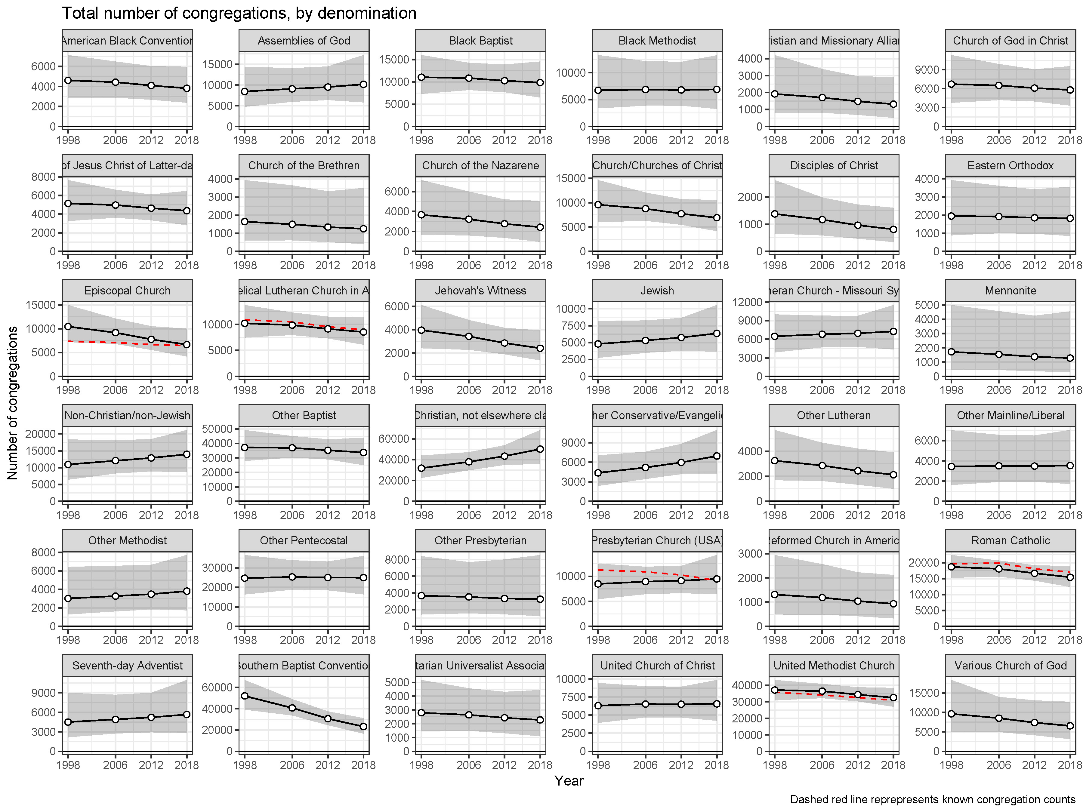

Slide 30
Data on congregations
National, self-reported census
- Yearbook of American and Canadian Churches
Small-area, self-reported census
- Internal denominational data
- US Religion Census
Hypernetwork samples
- National Congregations Study (NCS)
- US Congregational Life Survey
- National Study of Congregations’ Economic Practices
Notes:
National census: gets broad picture but may not be accurate for denominations with little institutional structure for data collection or who have more fluid relationships with their “member” congregations
Small-area census: great data on counts for a select number of congregations; but you don’t get congregation-specific data nor data on other denominations and non-denominational churches
Hypernetwork sample: can get congregation-level data on congregations from all denominations, then weight it to the population level; but is dramatically impacted by the sizes of the congregations (next slide)

Slide 31
Overview
Describe a model-based respondent-level analysis for inference at the congregation level
Compare the approach to the standard weighted approach
Estimate smoothed denominational counts and totals
Estimate total number of congregations closed
Discuss advantages, limitations, and next steps for the approach

Slide 32
Goals of congregational analyses
Achieve universal coverage
Generate accurate population-level estimates and confidence intervals at the level of congregations
Describe a diverse array of congregational characteristics

Slide 33
Work on hypernetwork samples
Highlight some “typical” congregational analyses (maybe from the most recent JSSR issue)
Discuss Hadaway + Marler and my work on counts/inferring to population totals

Slide 34
Data
Congregational data
NCS 1998, 2006, 2012, and 2018
¹Respondent data
GSS 1973-2020
¹Post-stratification data
ACS/Census
¹Calibration data
2000 US Religion Census
¹Not demonstrated in this presentation

Slide 35
Weighting vs modeling
Weighting
Use one regression model
Weight inversely to the size of the congregation
Modeling
Model both the outcome of interest and congregation size at the respondent level
Infer parameters at the congregation level from the two models combined

Slide 36
Future work
Use GSS data to predict denominational membership to further smooth estimates
Post-stratify to Census data
Use US Religion Census to calibrate results

Slide 37
Why model congregation size?
Proportion of congregations represented by a denomination might not change that much…
…but small congregations are highly influential…
…consequently, the weighted proportion may vary dramatically, even for well-represented denominations

